Slide 1


Formal Verification for Reliable AI Reasoning
Vikash Singh
PhD candidate
Case Western Reserve University

Slide 2

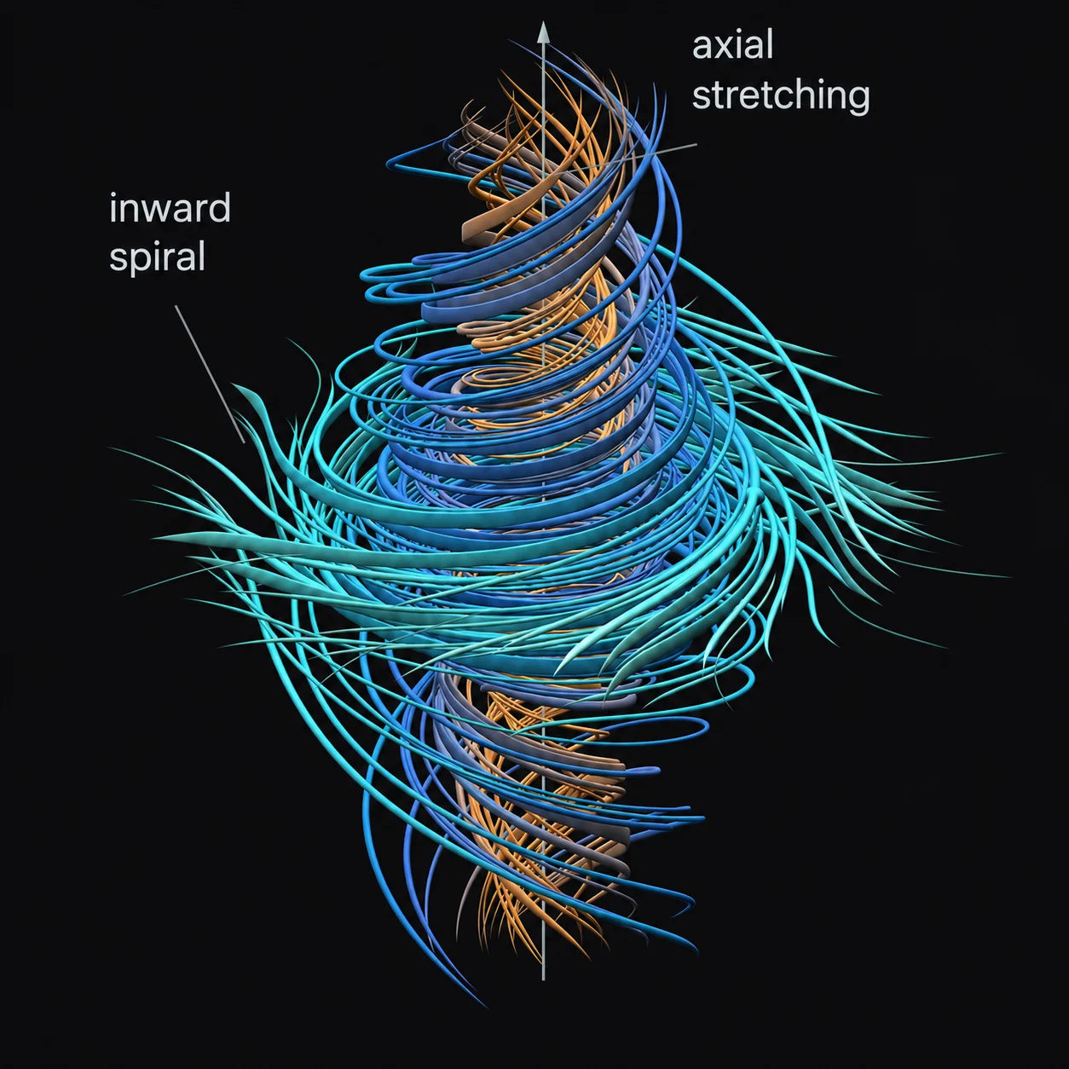
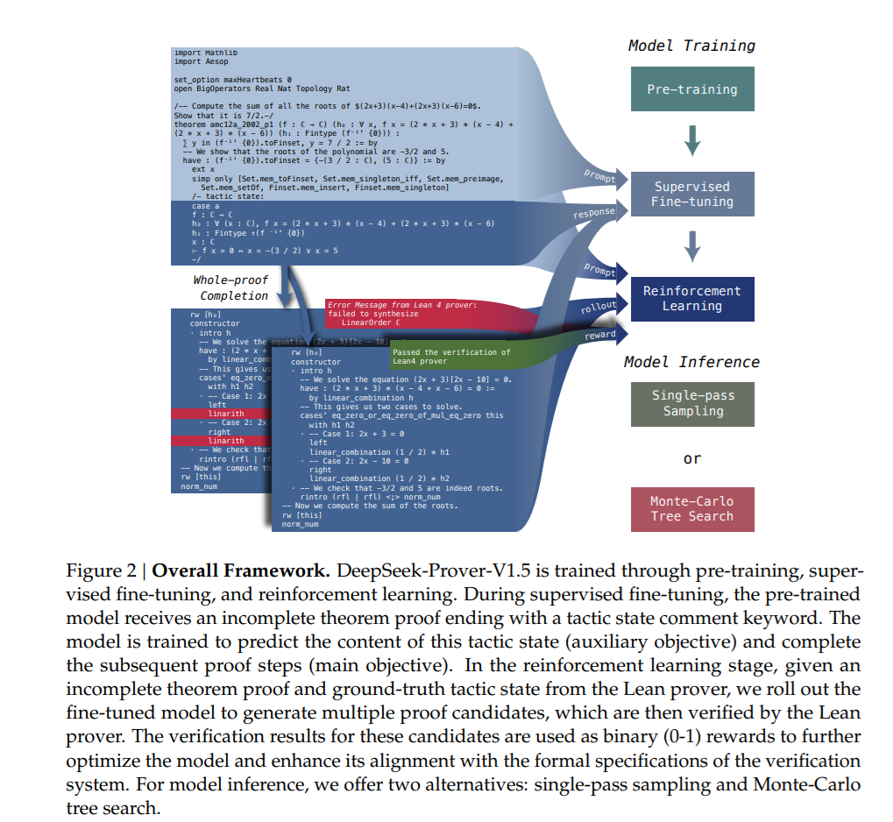

Slide 3
The Solver

Slide 4
The Solver: Z3 ( or SMT Solver or SAT Solvers(engine))

Slide 5
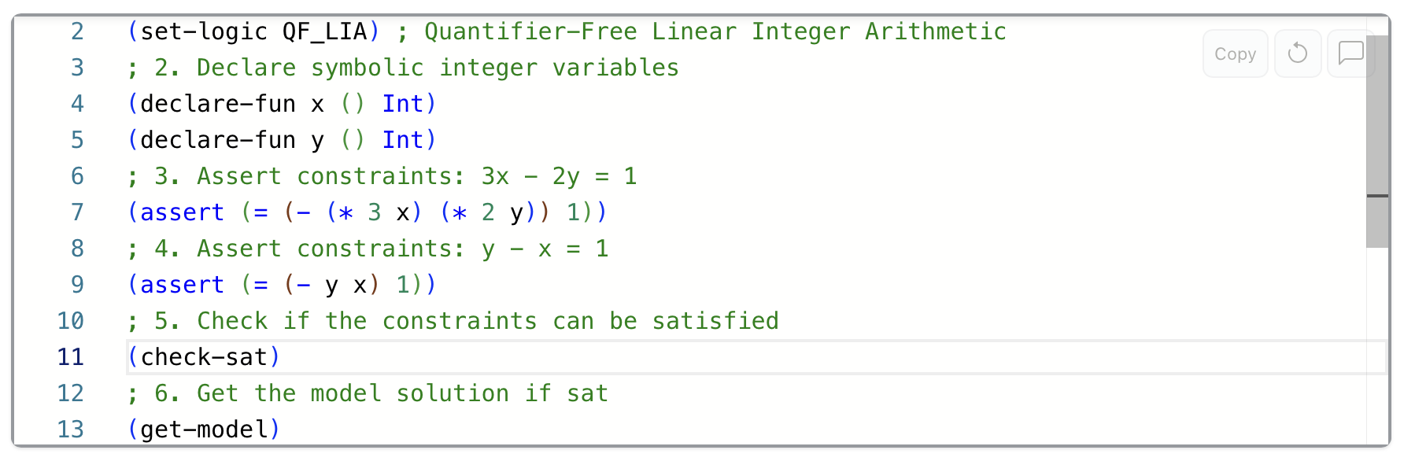
The Solver: Z3 ( or SMT Solver or SAT Solvers(engine))

Slide 6
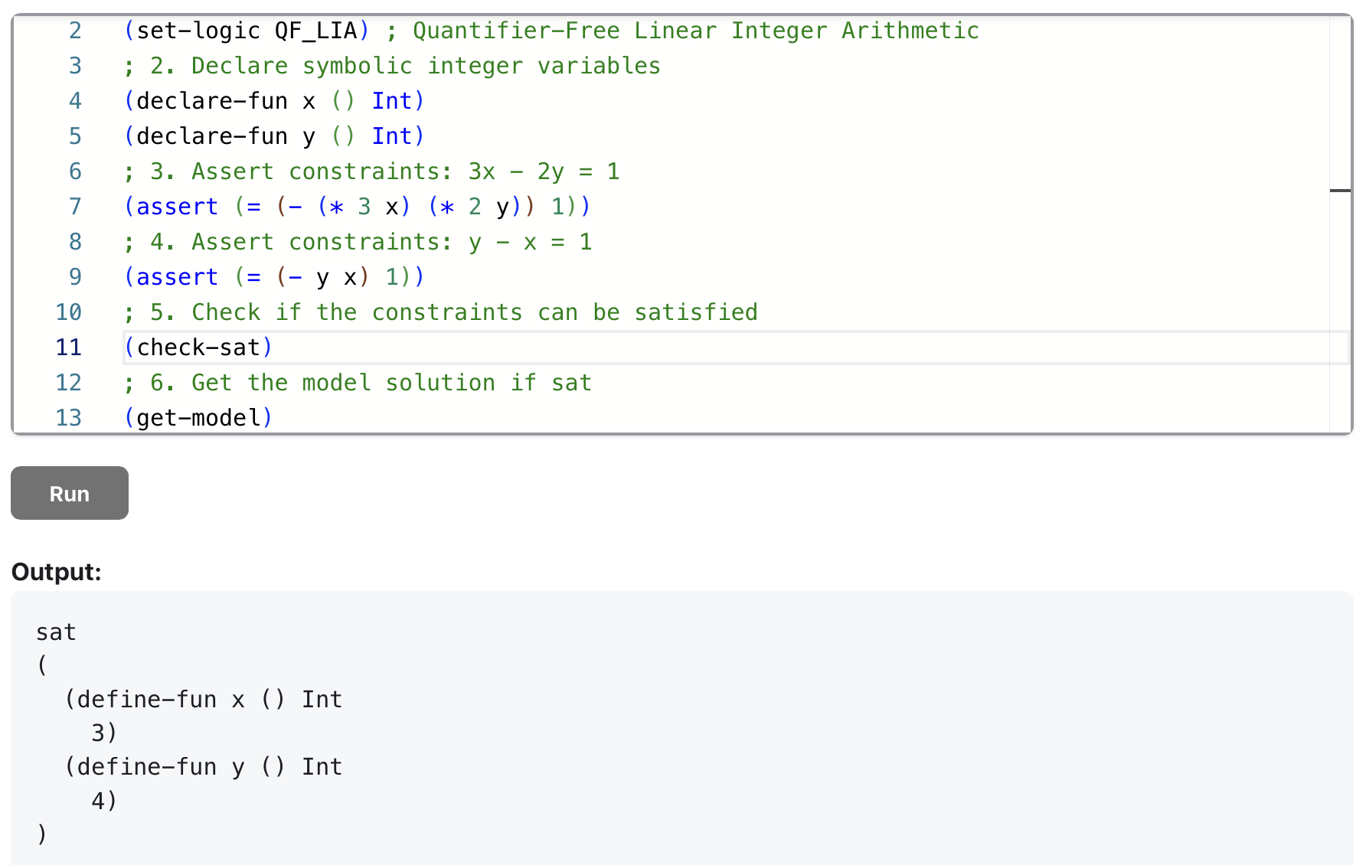
The Solver

Slide 7
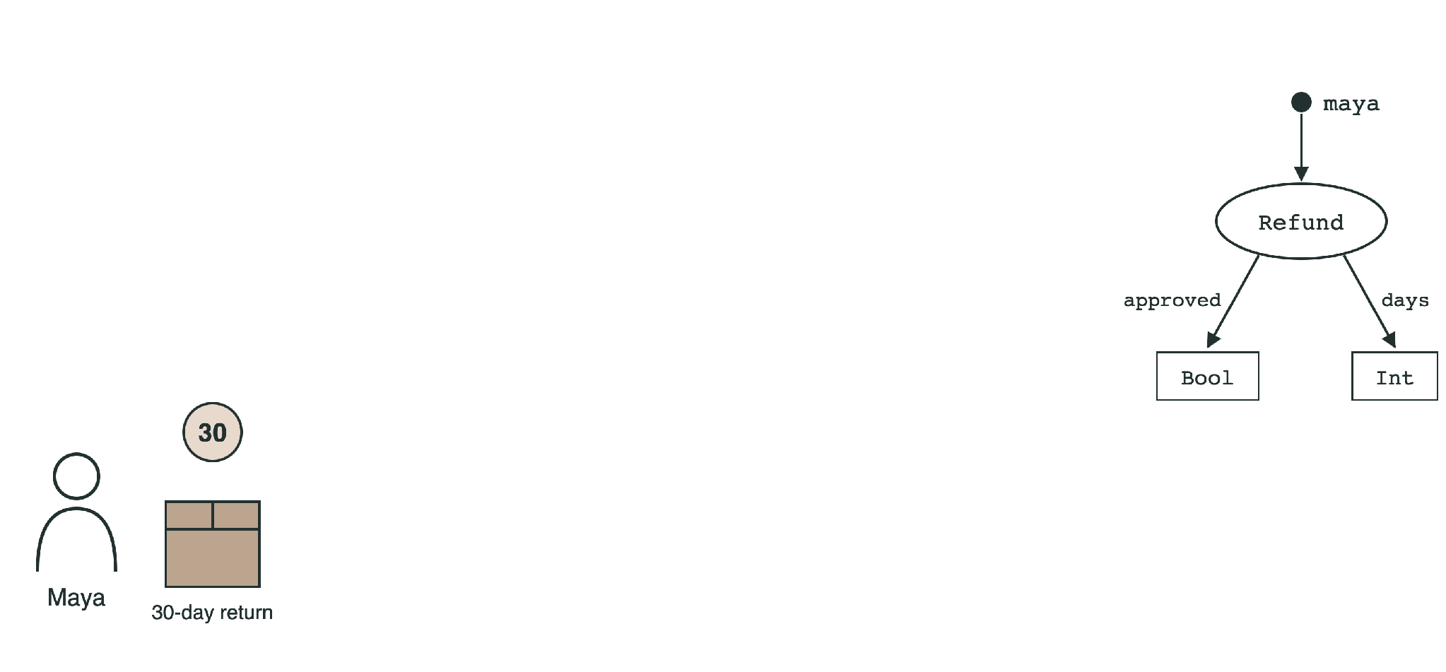
Q1
Can we turn language into something a solver can check?
Representation
Proof of Thought: language becomes JSON
Source
Selected JSON fragments
Types
“Maya’s refund was approved.”
“Refunds are approved only for returns within 30 days.”
When did she return the item?
sorts, functions, constants
Proof of Thought: Neurosymbolic Program Synthesis Allows Robust and Interpretable Reasoning, Ganguly et al. 2024

Slide 8
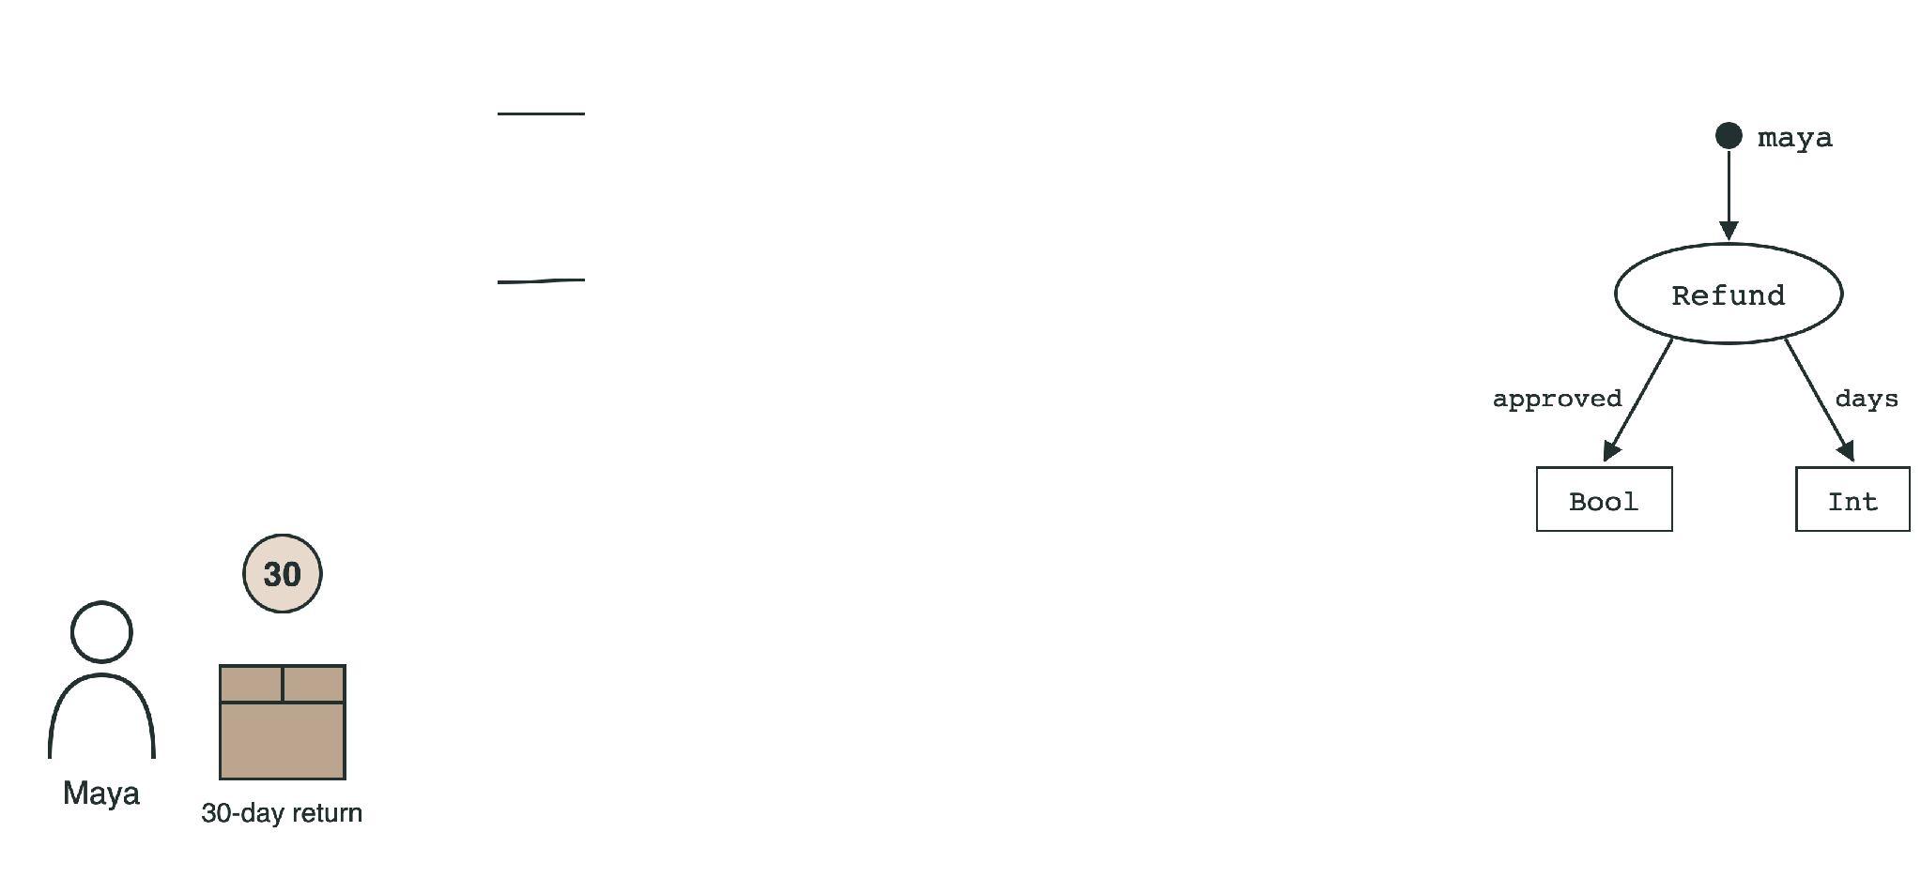
Q1
Can we turn language into something a solver can check?
Representation
Proof of Thought: language becomes JSON
Source
Selected JSON fragments
Types
“Maya’s refund was approved.”
"knowledge_base": ["approved(maya)"],
"rules": [{
"name": "Refund window",
“Refunds are approved only for returns within 30 days.”
"forall": [{"name": "r", "sort": "Refund"}],
"implies": {
"antecedent": "approved(r)",
"consequent": "days(r) <= 30"}}],
When did she return the item?
sorts, functions, constants
Proof of Thought: Neurosymbolic Program Synthesis Allows Robust and Interpretable Reasoning, Ganguly et al. 2024

Slide 9

Q1
Can we turn language into something a solver can check?
Representation
Proof of Thought: language becomes JSON
Source
Selected JSON fragments
Types
“Maya’s refund was approved.”
"knowledge_base": ["approved(maya)"],
"rules": [{
"name": "Refund window",
“Refunds are approved only for returns within 30 days.”
"forall": [{"name": "r", "sort": "Refund"}],
"implies": {
"antecedent": "approved(r)",
"consequent": "days(r) <= 30"}}],
"verifications": [{
When did she return the item?
"constraint": "days(maya) <= 30"}]
JSON structures the representation. It does not prove anything by itself.
sorts, functions, constants
Proof of Thought: Neurosymbolic Program Synthesis Allows Robust and Interpretable Reasoning, Ganguly et al. 2024

Slide 10

Q1
Can we turn language into something a solver can check?
Representation
The interpreter and the solver
JSON sections
types
sorts, functions, constants
fact
knowledge_base
rule
rules
goal
verifications

Slide 11
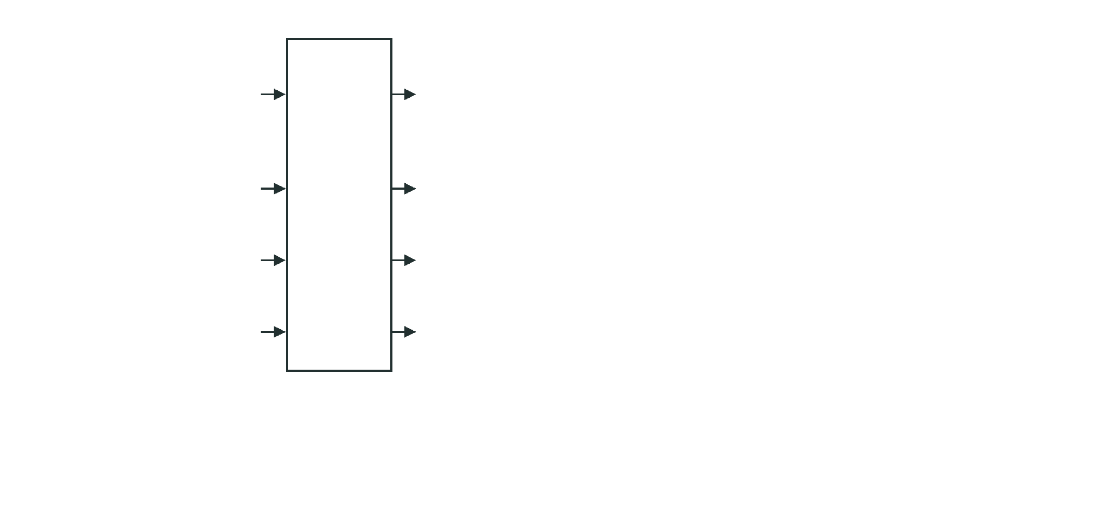
Q1
Can we turn language into something a solver can check?
Representation
The interpreter and the solver
JSON sections
Logical constraints
types
sort Refund; maya : Refund
sorts, functions, constants
approved : Refund → Bool
days : Refund → Int
typed interpreter
fact
approved(maya)
knowledge_base
checks sorts and arity
rule
∀r. approved(r) ⇒ days(r) ≤ 30
rules
goal
goal: days(maya) ≤ 30
verifications

Slide 12
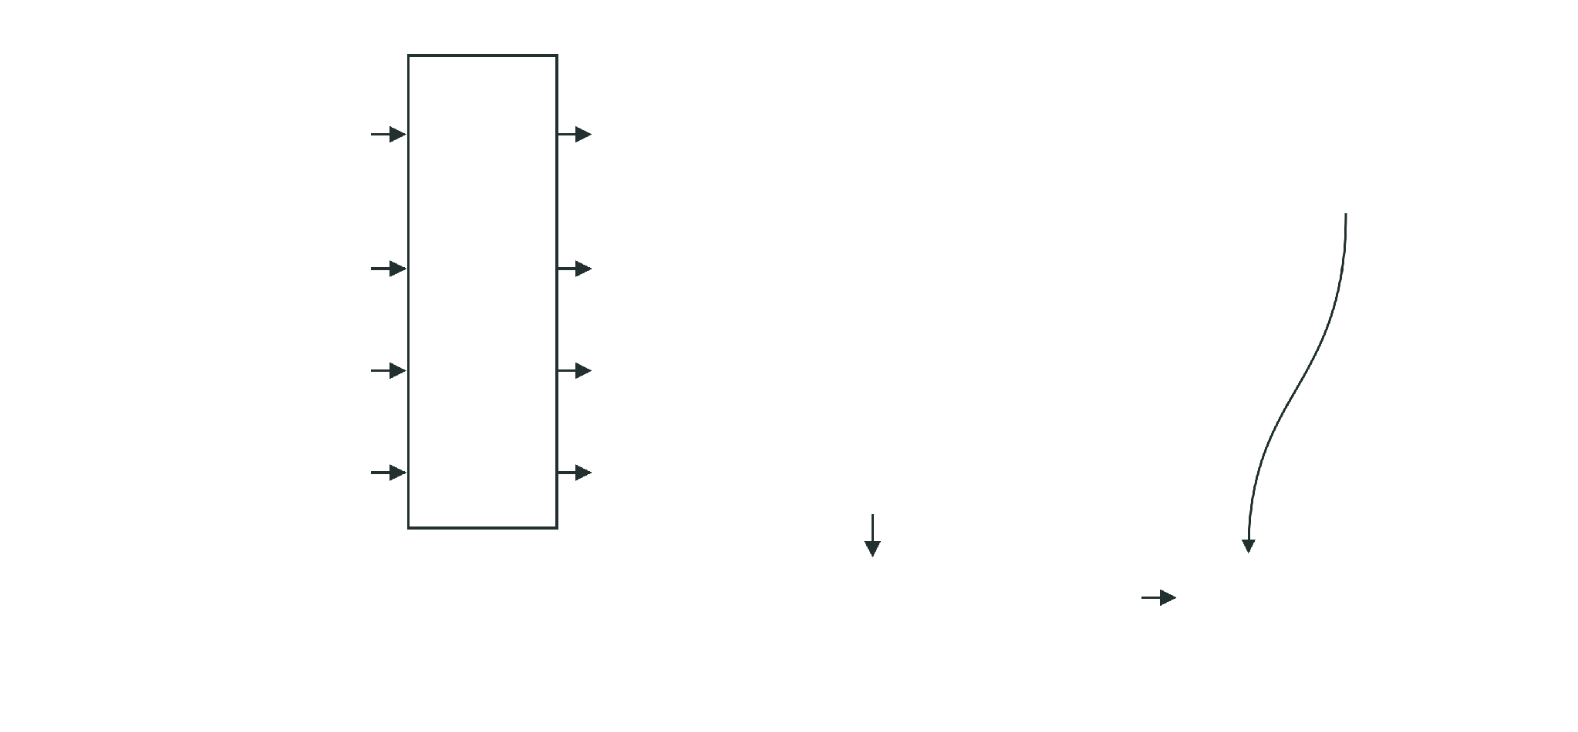
Q1
Can we turn language into something a solver can check?
Representation
The interpreter and the solver
JSON sections
Logical constraints
types
sort Refund; maya : Refund
PoT API call
approved : Refund → Bool
"actions":
["verify_conditions"]
sorts, functions, constants
days : Refund → Int
typed interpreter
fact
approved(maya)
knowledge_base
checks sorts and arity
rule
∀r. approved(r) ⇒ days(r) ≤ 30
rules
goal
goal: days(maya) ≤ 30
verifications
test
¬(days(maya) ≤ 30)
Z3

Slide 13
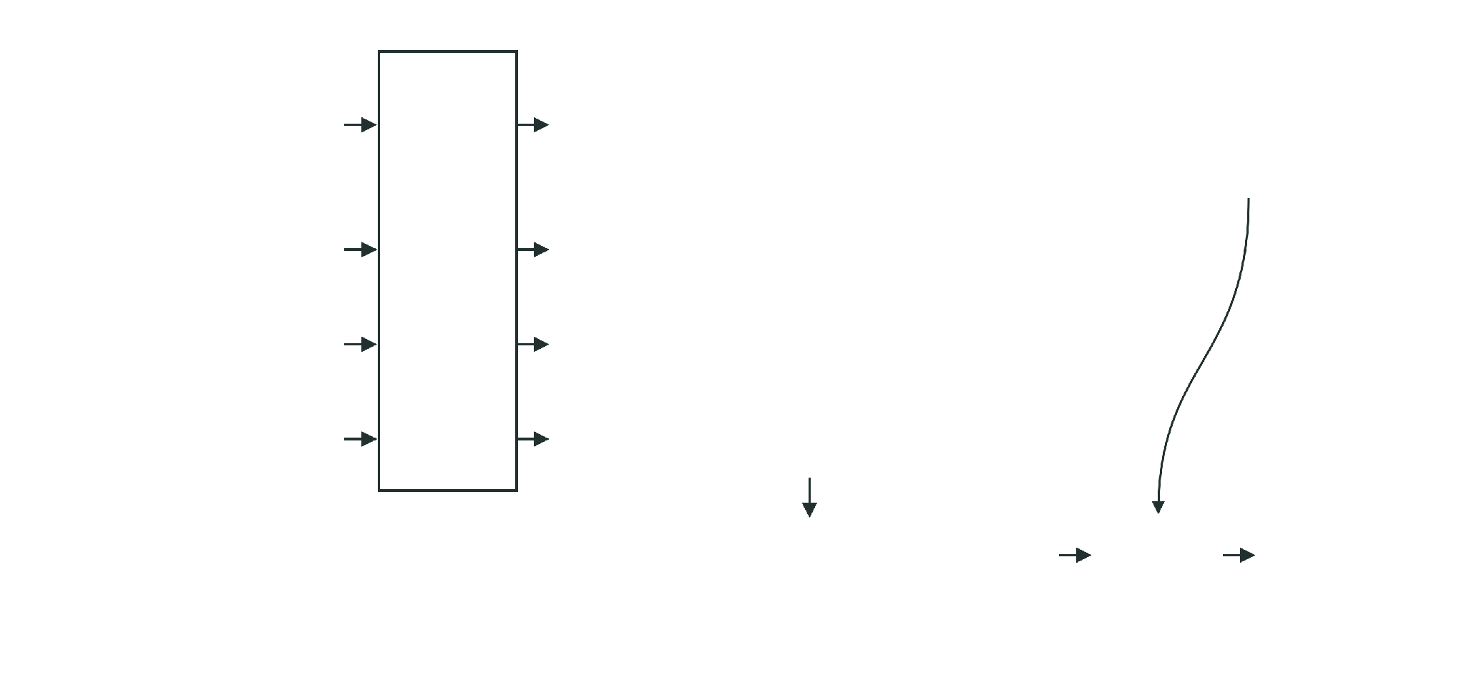
Q1
Can we turn language into something a solver can check?
Representation
The interpreter and the solver
JSON sections
Logical constraints
types
sort Refund; maya : Refund
PoT API call
approved : Refund → Bool
"actions":
["verify_conditions"]
sorts, functions, constants
days : Refund → Int
typed interpreter
fact
approved(maya)
knowledge_base
checks sorts and arity
rule
∀r. approved(r) ⇒ days(r) ≤ 30
rules
goal
goal: days(maya) ≤ 30
verifications
test
¬(days(maya) ≤ 30)
Z3
unsat
goal entailed ✓
The goal holds when the facts, the rule, and the negated goal have no model together.

Slide 14
Q1
Can we turn language into something a solver can check?
Representation
Logic-LM and LINC

Slide 15
Q1
Can we turn language into something a solver can check?
Representation
Logic-LM and LINC
LINC
Olausson et al.
Parse into first-order logic. Prover9 deduces.
k=1 ∀x (Appr(x) → InWindow(x))
k=2 ∀x (Appr(x) → InWindow(x))
k=3 ∀x (InWindow(x) → Appr(x))
Appr(maya) ⊢? InWindow(maya)
↓ Prover9 on each parse
True · True · Unknown
majority vote: True

Slide 16
Q1
Can we turn language into something a solver can check?
Representation
Logic-LM and LINC
LINC
Olausson et al.
Logic-LM
Pan et al.
Parse into first-order logic. Prover9 deduces.
Formulate for a task-appropriate solver.
k=1 ∀x (Appr(x) → InWindow(x))
logic programming
FOL prover
CSP
SAT
k=2 ∀x (Appr(x) → InWindow(x))
k=3 ∀x (InWindow(x) → Appr(x))
Appr(maya) ∧ ∀x (Appr(x) → InWindow(x))
Appr(maya) ⊢? InWindow(maya)
goal: InWndw(maya)
↓ Prover9 on each parse
error: unknown predicate InWndw
True · True · Unknown
↺ error fed back, formulation refined
majority vote: True

Slide 17
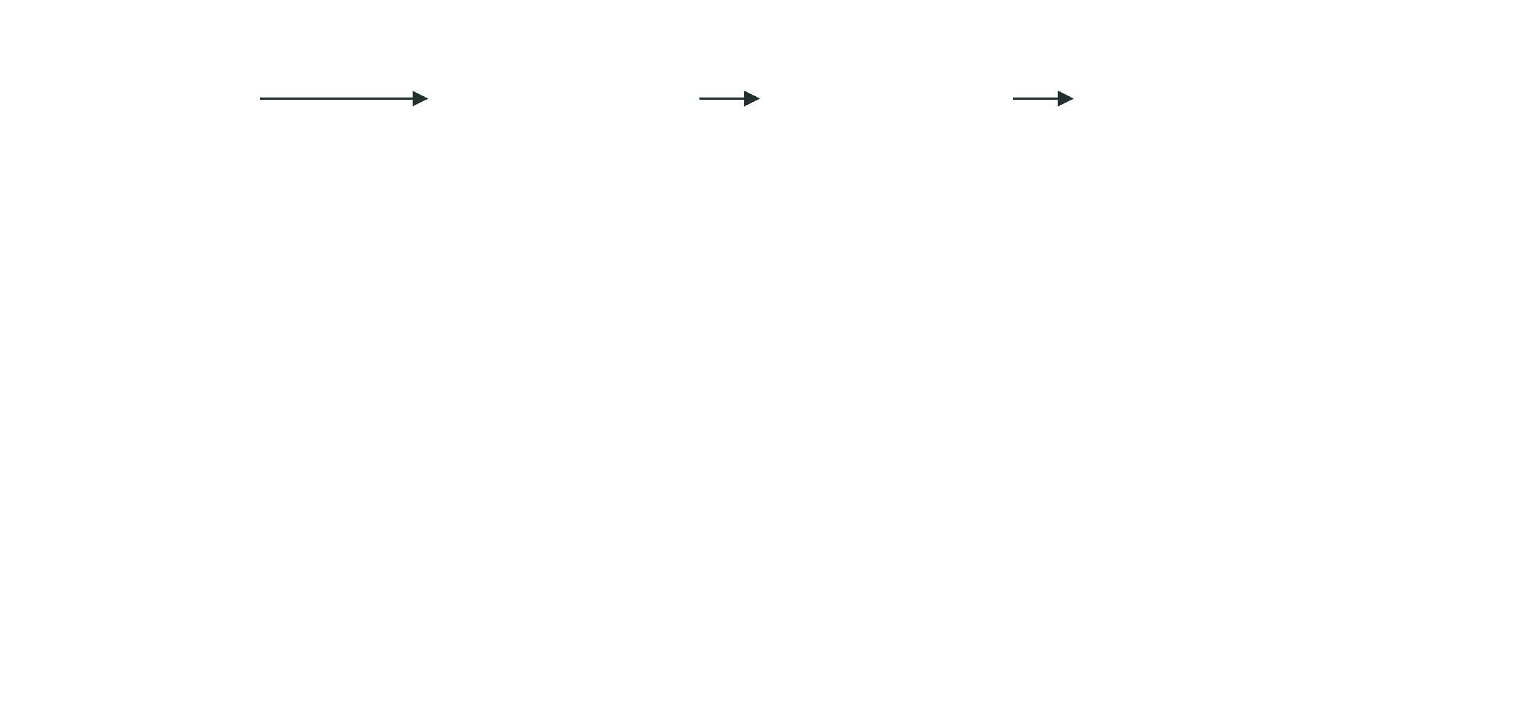
Q1
Can we turn language into something a solver can check?
Representation
The cost of a custom representation
source text
JSON DSL
interpreter
Z3

Slide 18
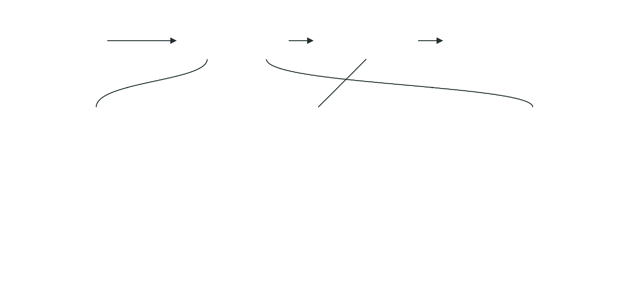
Q1
Can we turn language into something a solver can check?
Representation
The cost of a custom representation
source text
JSON DSL
interpreter
Z3
1 · Schema in every prompt
2 · A custom interpreter
3 · Representation changes
keys: sorts, functions,
parser
"knowledge": [...]
constants, knowledge_base,
type checker
"knowledge_base": [...]
rules, verifications, actions
calls into Z3
all maintained by the project
old programs no longer parse

Slide 19
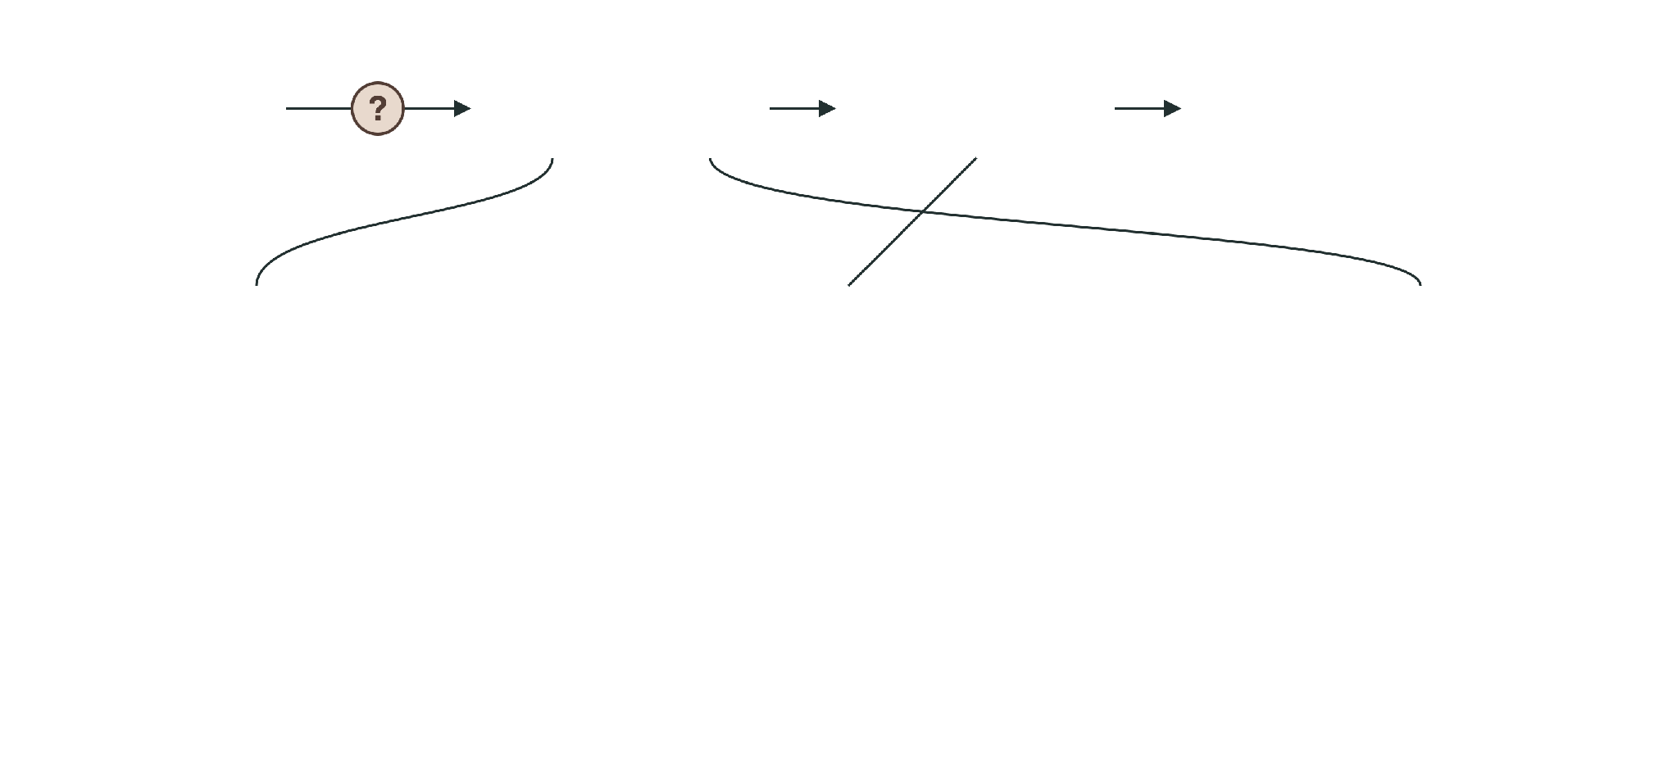
Q1
Can we turn language into something a solver can check?
Representation
The cost of a custom representation
source text
JSON DSL
interpreter
Z3
1 · Schema in every prompt
2 · A custom interpreter
3 · Representation changes
keys: sorts, functions,
parser
"knowledge": [...]
constants, knowledge_base,
type checker
"knowledge_base": [...]
rules, verifications, actions
calls into Z3
all maintained by the project
old programs no longer parse
?
A separate question: does the artifact preserve the source meaning?

Slide 20
Q1
Can we turn language into something a solver can check?
Representation
The cost of a custom representation
source text
JSON DSL
interpreter
Z3
1 · Schema in every prompt
2 · A custom interpreter
3 · Representation changes
keys: sorts, functions,
parser
"knowledge": [...]
constants, knowledge_base,
type checker
"knowledge_base": [...]
rules, verifications, actions
calls into Z3
all maintained by the project
old programs no longer parse
?
A separate question: does the artifact preserve the source meaning?
Could the model write a standard solver language directly?

Slide 21
Q2
Can we make the representation easier to generate?
Standard language
The same source in SMT-LIB
Source
SMT-LIB
Z3 output · expected
“Refunds are approved only
for returns within 30 days.
Maya’s refund was approved.”
Rule grounded for Maya’s refund. The JSON rule was quantified.

Slide 22

Q2
Can we make the representation easier to generate?
Standard language
The same source in SMT-LIB
Source
SMT-LIB
Z3 output · expected
“Refunds are approved only
(set-logic QF_LIA)
for returns within 30 days.
(declare-const approved Bool)
Maya’s refund was approved.”
(declare-const days Int)
(assert (=> approved (<= days 30)))
(assert approved)
Rule grounded for Maya’s refund. The JSON rule was quantified.

Slide 23
Q2
Can we make the representation easier to generate?
Standard language
The same source in SMT-LIB
Source
SMT-LIB
Z3 output · expected
“Refunds are approved only
(set-logic QF_LIA)
for returns within 30 days.
(declare-const approved Bool)
Maya’s refund was approved.”
(declare-const days Int)
(assert (=> approved (<= days 30)))
(assert approved)
(check-sat)
sat
consistent
Rule grounded for Maya’s refund. The JSON rule was quantified.

Slide 24

Q2
Can we make the representation easier to generate?
Standard language
The same source in SMT-LIB
Source
SMT-LIB
Z3 output · expected
“Refunds are approved only
(set-logic QF_LIA)
for returns within 30 days.
(declare-const approved Bool)
Maya’s refund was approved.”
(declare-const days Int)
(assert (=> approved (<= days 30)))
(assert approved)
(check-sat)
sat
consistent
(push 1)
(assert (not (<= days 30)))
(check-sat)
unsat
entailed ✓
(pop 1)
Rule grounded for Maya’s refund. The JSON rule was quantified.
sat and unsat answer the query asked: a consistent context, then no counterexample to days ≤ 30.

Slide 25
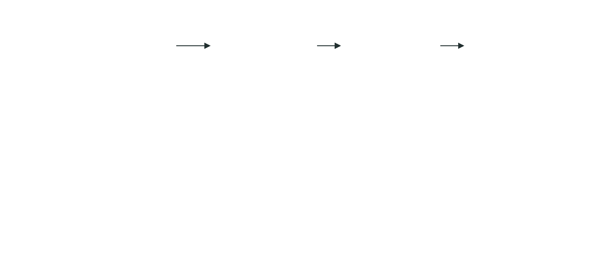
Q2
Can we make the representation easier to generate?
Standard language
Why standard SMT-LIB helps
Proof of Thought path
source + schema
JSON DSL
custom interpreter
Z3
Grammars of Formal Uncertainty: When to Trust LLMs in Automated Reasoning Tasks, Ganguly and Singh et al. , 2025

Slide 26
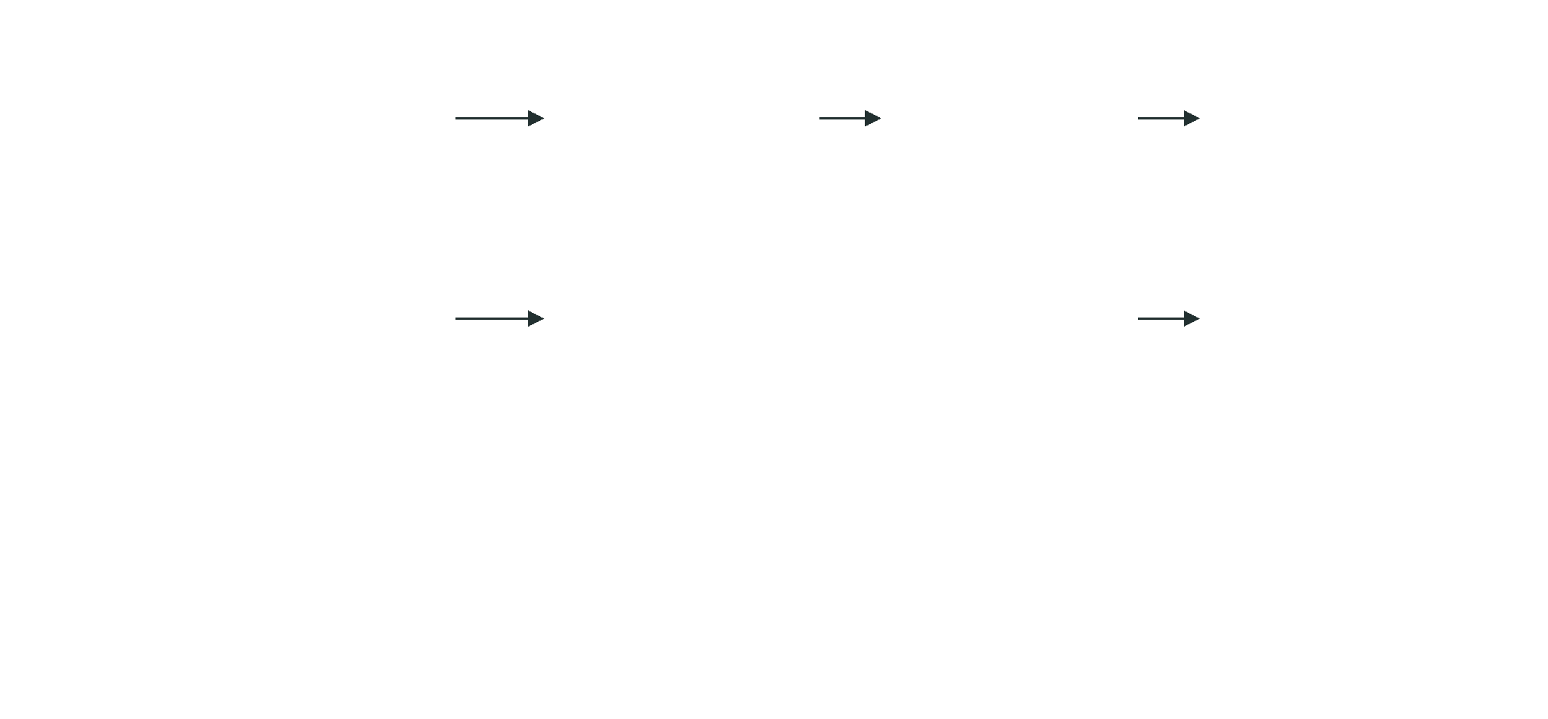
Q2
Can we make the representation easier to generate?
Standard language
Why standard SMT-LIB helps
Proof of Thought path
source + schema
JSON DSL
custom interpreter
Z3
Grammars path
source
SMT-LIB, a standard solver language
Z3
parses it directly
Grammars of Formal Uncertainty: When to Trust LLMs in Automated Reasoning Tasks, Ganguly and Singh et al. , 2025

Slide 27
Q2
Can we make the representation easier to generate?
Standard language
Why standard SMT-LIB helps
Proof of Thought path
source + schema
JSON DSL
custom interpreter
Z3
Grammars path
source
SMT-LIB, a standard solver language
Z3
parses it directly
Less custom engineering
Valid programs sooner
Shorter prompts
no project-specific DSL to maintain
more syntactically valid, fewer attempts
fewer prompt tokens than the PoT pipeline
Grammars of Formal Uncertainty: When to Trust LLMs in Automated Reasoning Tasks, Ganguly and Singh et al. , 2025

Slide 28
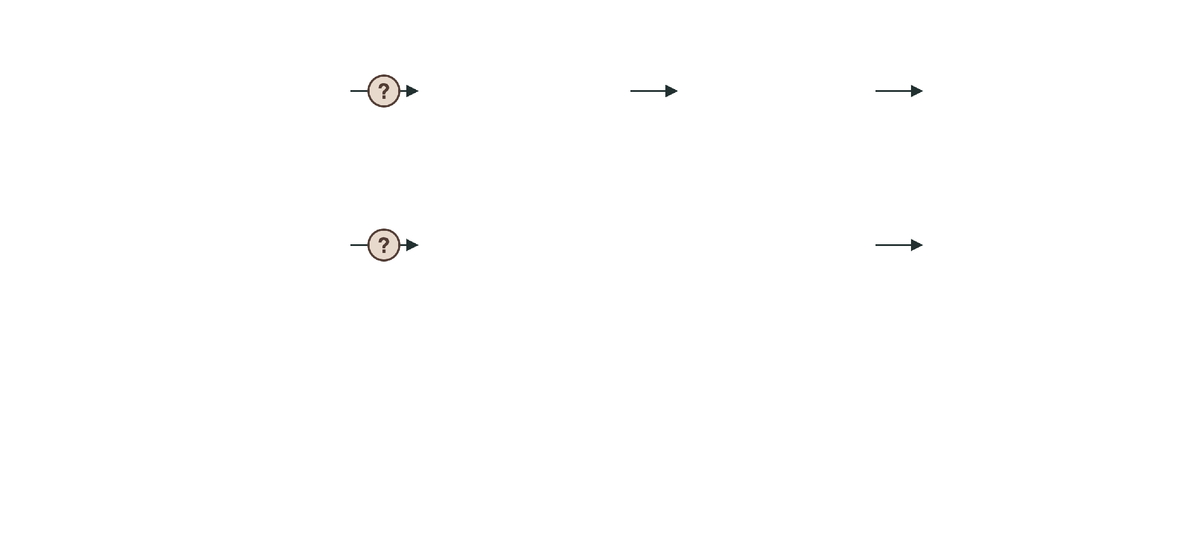
Q2
Can we make the representation easier to generate?
Standard language
Why standard SMT-LIB helps
Proof of Thought path
source + schema
JSON DSL
custom interpreter
Z3
Grammars path
source
SMT-LIB, a standard solver language
Z3
parses it directly
Less custom engineering
Valid programs sooner
Shorter prompts
no project-specific DSL to maintain
more syntactically valid, fewer attempts
fewer prompt tokens than the PoT pipeline
Faithfulness to the source is still open…….
Grammars of Formal Uncertainty: When to Trust LLMs in Automated Reasoning Tasks, Ganguly and Singh et al. , 2025

Slide 29
Q2
Can we make the representation easier to generate?
Standard language
Grammars of Formal Uncertainty
Three sampled programs for “within 30 days” · illustrative
c1
(=> approved (<= days 30))
faithful
c2
(=> approved (not (> days 30)))
equivalent, different syntax
c3
(=> approved (< days 30))
excludes day 30
Grammars of Formal Uncertainty: When to Trust LLMs in Automated Reasoning Tasks, Ganguly and Singh et al. , 2025

Slide 30
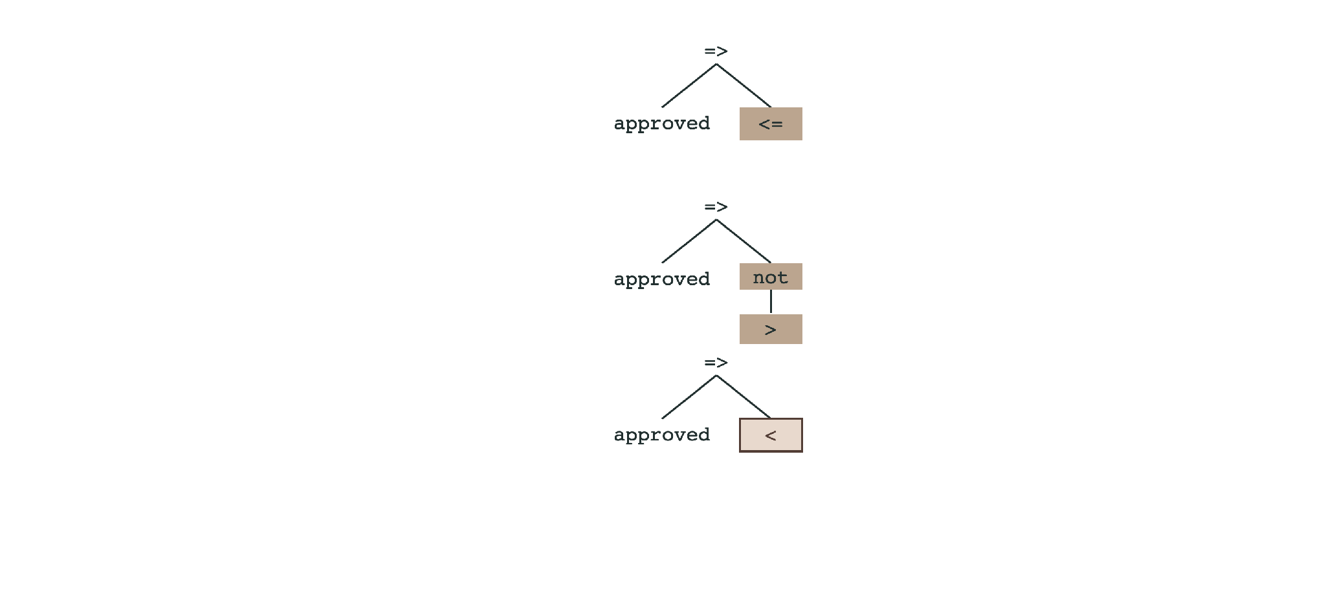
Q2
Can we make the representation easier to generate?
Standard language
Grammars of Formal Uncertainty
Three sampled programs for “within 30 days” · illustrative
c1
(=> approved (<= days 30))
faithful
c2
(=> approved (not (> days 30)))
equivalent, different syntax
c3
(=> approved (< days 30))
excludes day 30
Grammars of Formal Uncertainty: When to Trust LLMs in Automated Reasoning Tasks, Ganguly and Singh et al. , 2025

Slide 31
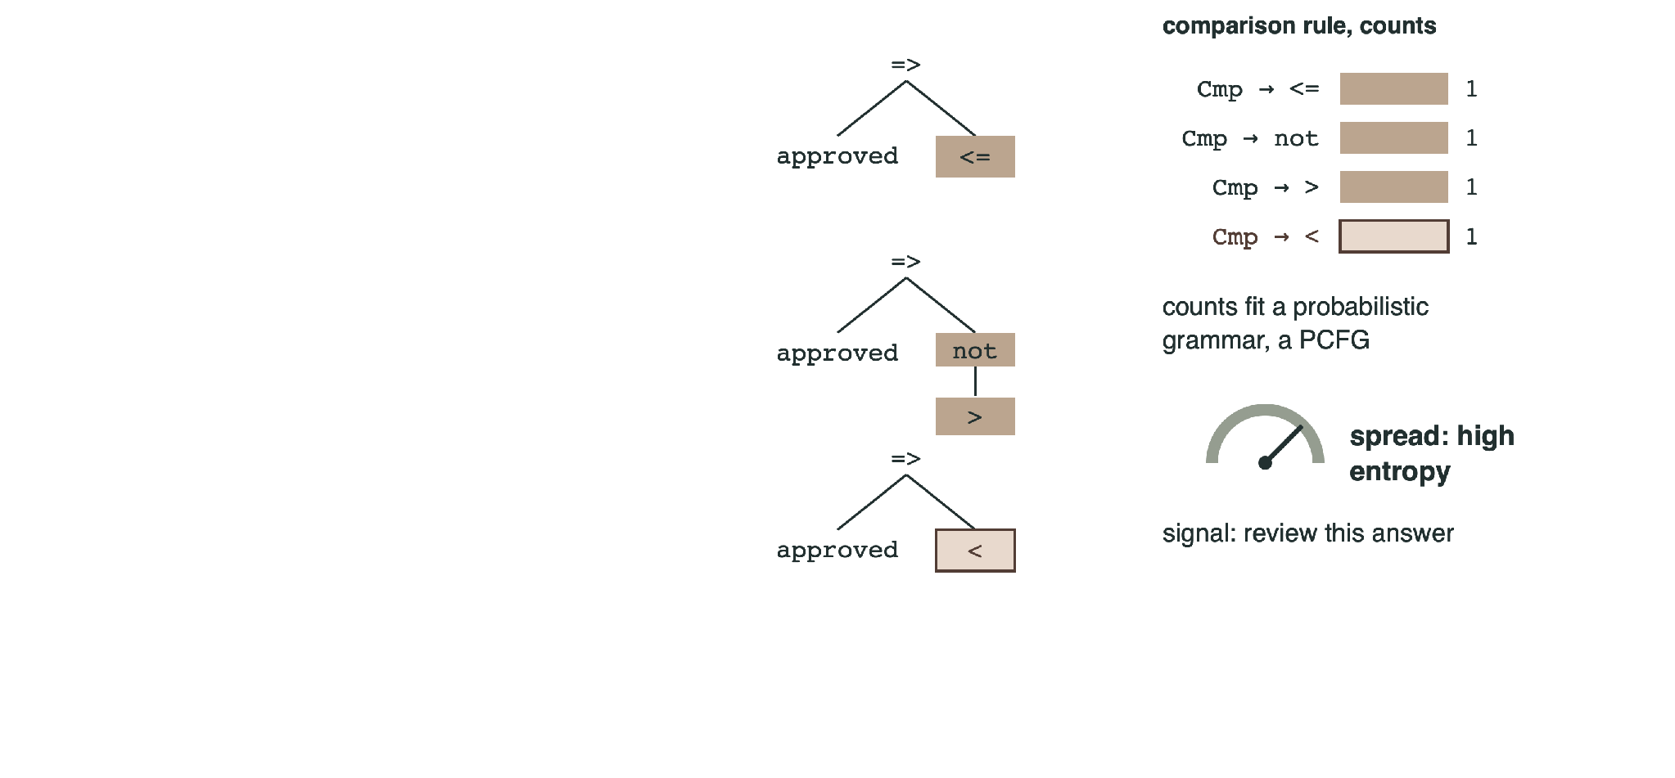
Q2
Can we make the representation easier to generate?
Standard language
Grammars of Formal Uncertainty
Three sampled programs for “within 30 days” · illustrative
c1
(=> approved (<= days 30))
faithful
c2
(=> approved (not (> days 30)))
equivalent, different syntax
c3
(=> approved (< days 30))
excludes day 30
Grammars of Formal Uncertainty: When to Trust LLMs in Automated Reasoning Tasks, Ganguly and Singh et al. , 2025

Slide 32
Q2
Can we make the representation easier to generate?
Standard language
Grammars of Formal Uncertainty
Three sampled programs for “within 30 days” · illustrative
c1
(=> approved (<= days 30))
faithful
c2
(=> approved (not (> days 30)))
equivalent, different syntax
c3
(=> approved (< days 30))
excludes day 30
Spread across rules signals uncertainty. Not every syntactic difference is an error, and agreement can be wrong.
Grammars of Formal Uncertainty: When to Trust LLMs in Automated Reasoning Tasks, Ganguly and Singh et al. , 2025

Slide 33
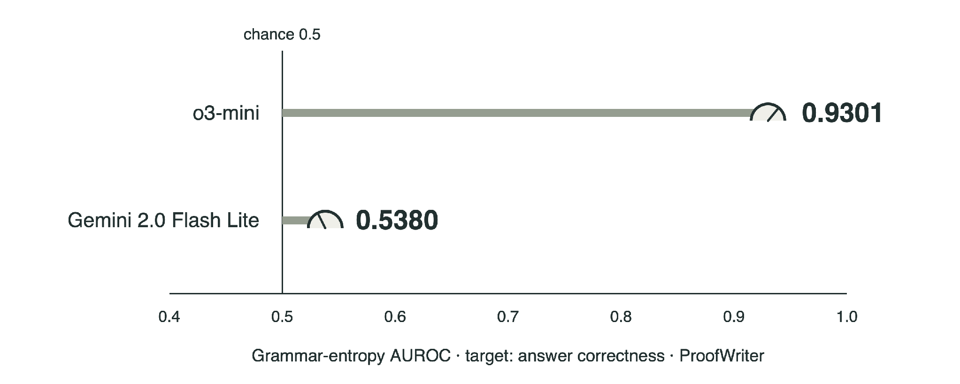
Q2
Can we make the representation easier to generate?
Standard language
What the uncertainty results show
Strong for one model, weak for another.
Grammars of Formal Uncertainty: When to Trust LLMs in Automated Reasoning Tasks, Ganguly and Singh et al. , 2025

Slide 34

Q2
Can we make the representation easier to generate?
Standard language
VeriCoT: checking the reasoning steps
Source premises
Refunds are approved only for returns within 30 days.
Maya’s refund was approved.
VeriCoT: Neuro-Symbolic Chain-of-Thought Validation via Logical Consistency Checks, Feng et al. · illustrative graph

Slide 35
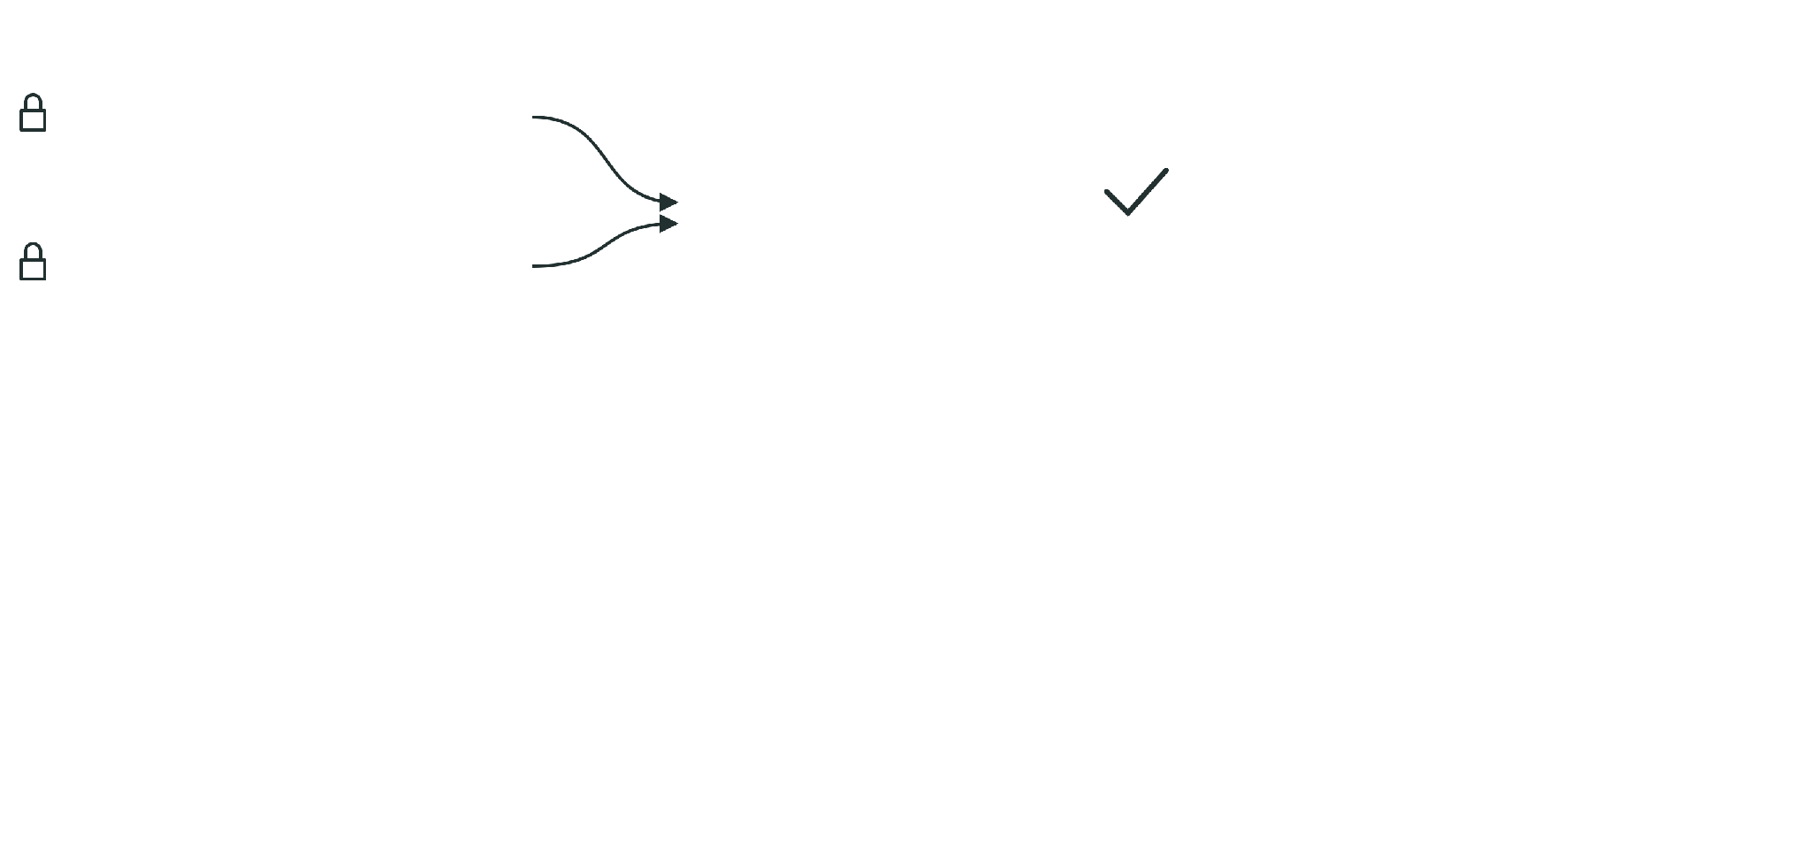
Q2
Can we make the representation easier to generate?
Standard language
VeriCoT: checking the reasoning steps
Source premises
Refunds are approved only for returns within 30 days.
step 1
entailed by the source premises
days ≤ 30
Maya’s refund was approved.
VeriCoT: Neuro-Symbolic Chain-of-Thought Validation via Logical Consistency Checks, Feng et al. , 2025

Slide 36
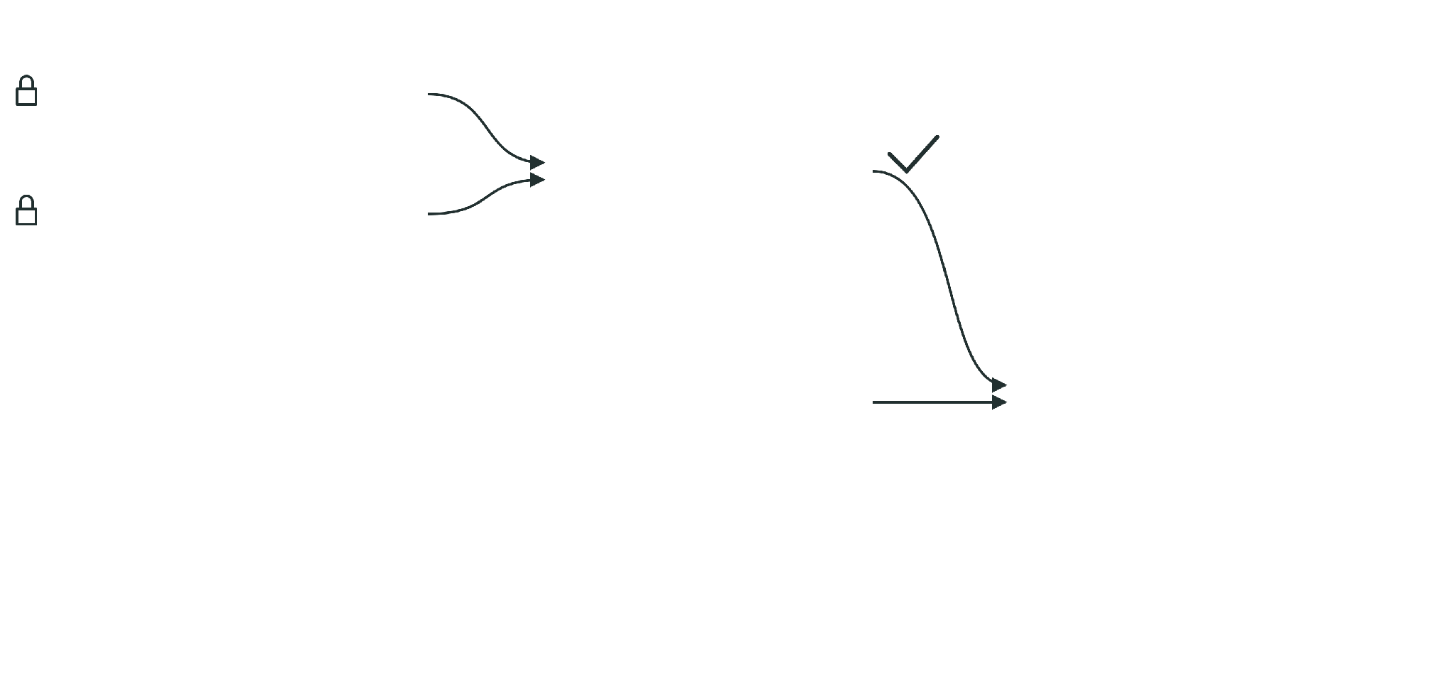
Q2
Can we make the representation easier to generate?
Standard language
VeriCoT: checking the reasoning steps
Source premises
Refunds are approved only for returns within 30 days.
step 1
entailed by the source premises
days ≤ 30
Maya’s refund was approved.
proposed support
step 2 · valid given support
“Returned on day 12.”
days = 12
VeriCoT: Neuro-Symbolic Chain-of-Thought Validation via Logical Consistency Checks, Feng et al. , 2025

Slide 37
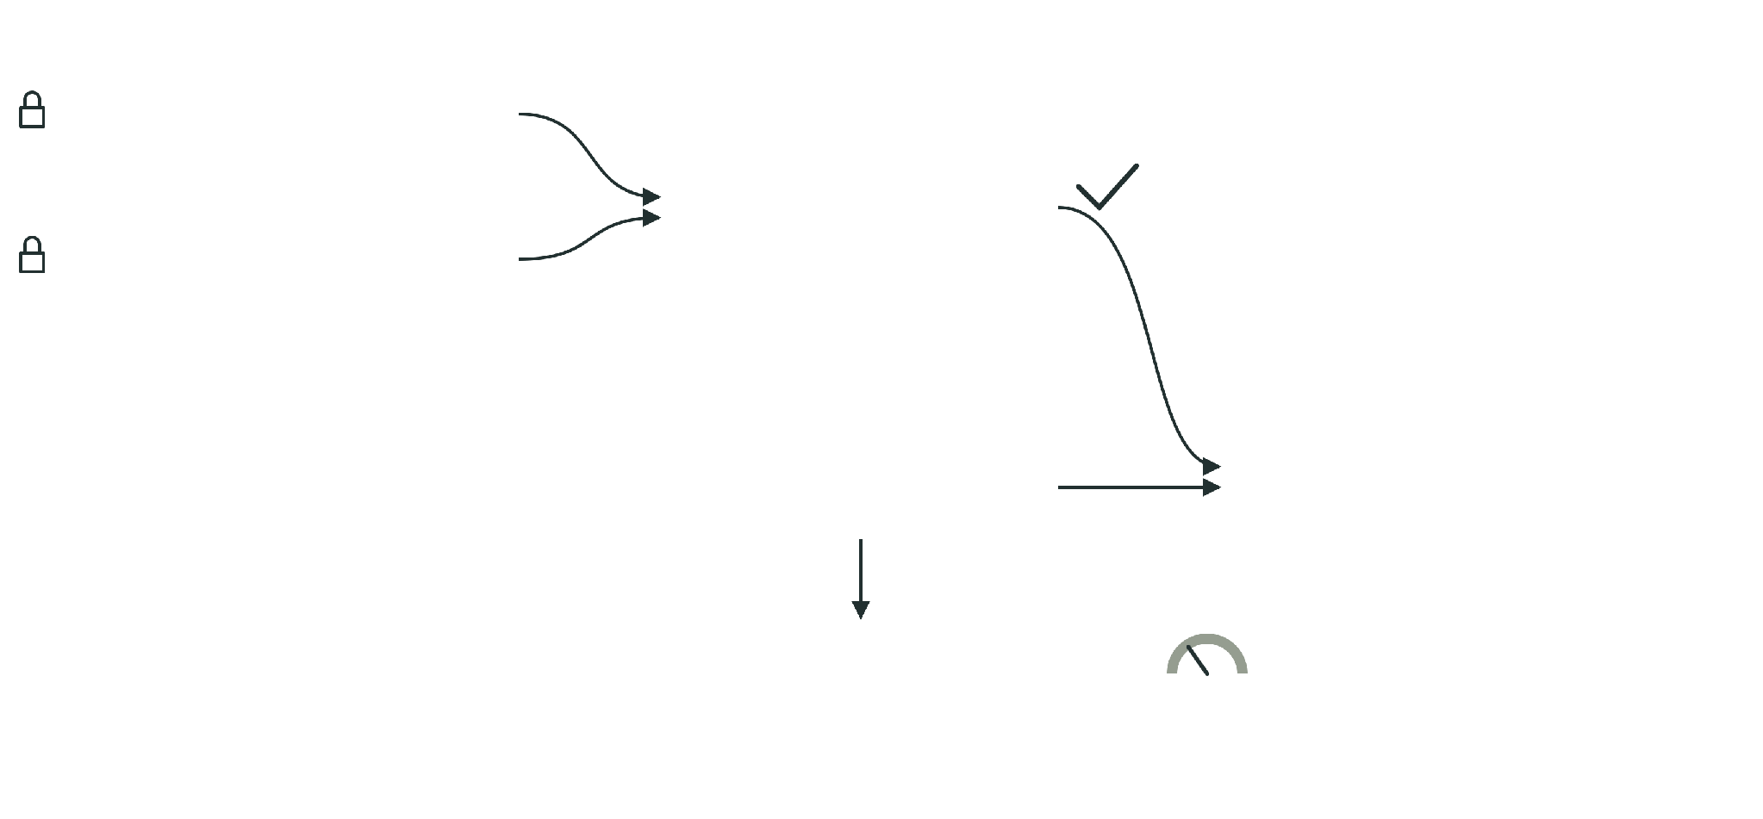
Q2
Can we make the representation easier to generate?
Standard language
VeriCoT: checking the reasoning steps
Source premises
Refunds are approved only for returns within 30 days.
step 1
entailed by the source premises
days ≤ 30
Maya’s refund was approved.
proposed support
step 2 · valid given support
“Returned on day 12.”
days = 12
Is the support in the source?
not grounded
grounding check, may use an LLM judge
Valid steps over generated formulas still depend on a faithful translation.
VeriCoT: Neuro-Symbolic Chain-of-Thought Validation via Logical Consistency Checks, Feng et al. , 2025

Slide 38

Q3
Does the formal artifact preserve the source meaning?
Faithfulness
An executable mistranslation
Source: “within 30 days”
Z3 output · expected
faithful
(assert approved)
(assert (=> approved (<= days 30)))
(check-sat)
Beyond Solver Verdicts: Generative Reward Models for Autoformalization, Singh et al. , 2026

Slide 39

Q3
Does the formal artifact preserve the source meaning?
Faithfulness
An executable mistranslation
Source: “within 30 days”
Z3 output · expected
faithful
(assert approved)
(assert (=> approved (<= days 30)))
(check-sat)
candidate
(assert approved)
(assert (=> approved (< days 30)))
(check-sat)
Beyond Solver Verdicts: Generative Reward Models for Autoformalization, Singh et al. , 2026

Slide 40
Q3
Does the formal artifact preserve the source meaning?
Faithfulness
An executable mistranslation
Source: “within 30 days”
Z3 output · expected
faithful
(assert approved)
(assert (=> approved (<= days 30)))
(check-sat)
sat
candidate
(assert approved)
(assert (=> approved (< days 30)))
(check-sat)
sat
same verdict
Beyond Solver Verdicts: Generative Reward Models for Autoformalization, Singh et al. , 2026

Slide 41
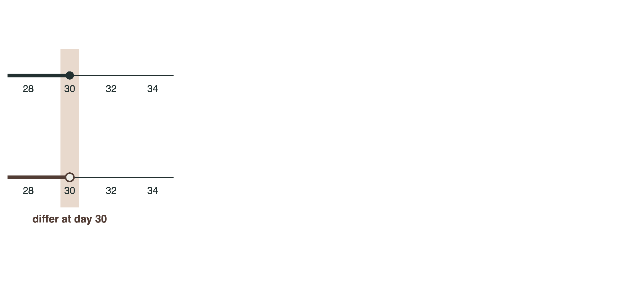
Q3
Does the formal artifact preserve the source meaning?
Faithfulness
An executable mistranslation
Source: “within 30 days”
Z3 output · expected
faithful
(assert approved)
(assert (=> approved (<= days 30)))
(check-sat)
sat
candidate
(assert approved)
(assert (=> approved (< days 30)))
(check-sat)
sat
same verdict
Verdict-preserving unfaithfulness: the meaning changed, the verdict did not.
Beyond Solver Verdicts: Generative Reward Models for Autoformalization, Singh et al. , 2026

Slide 42
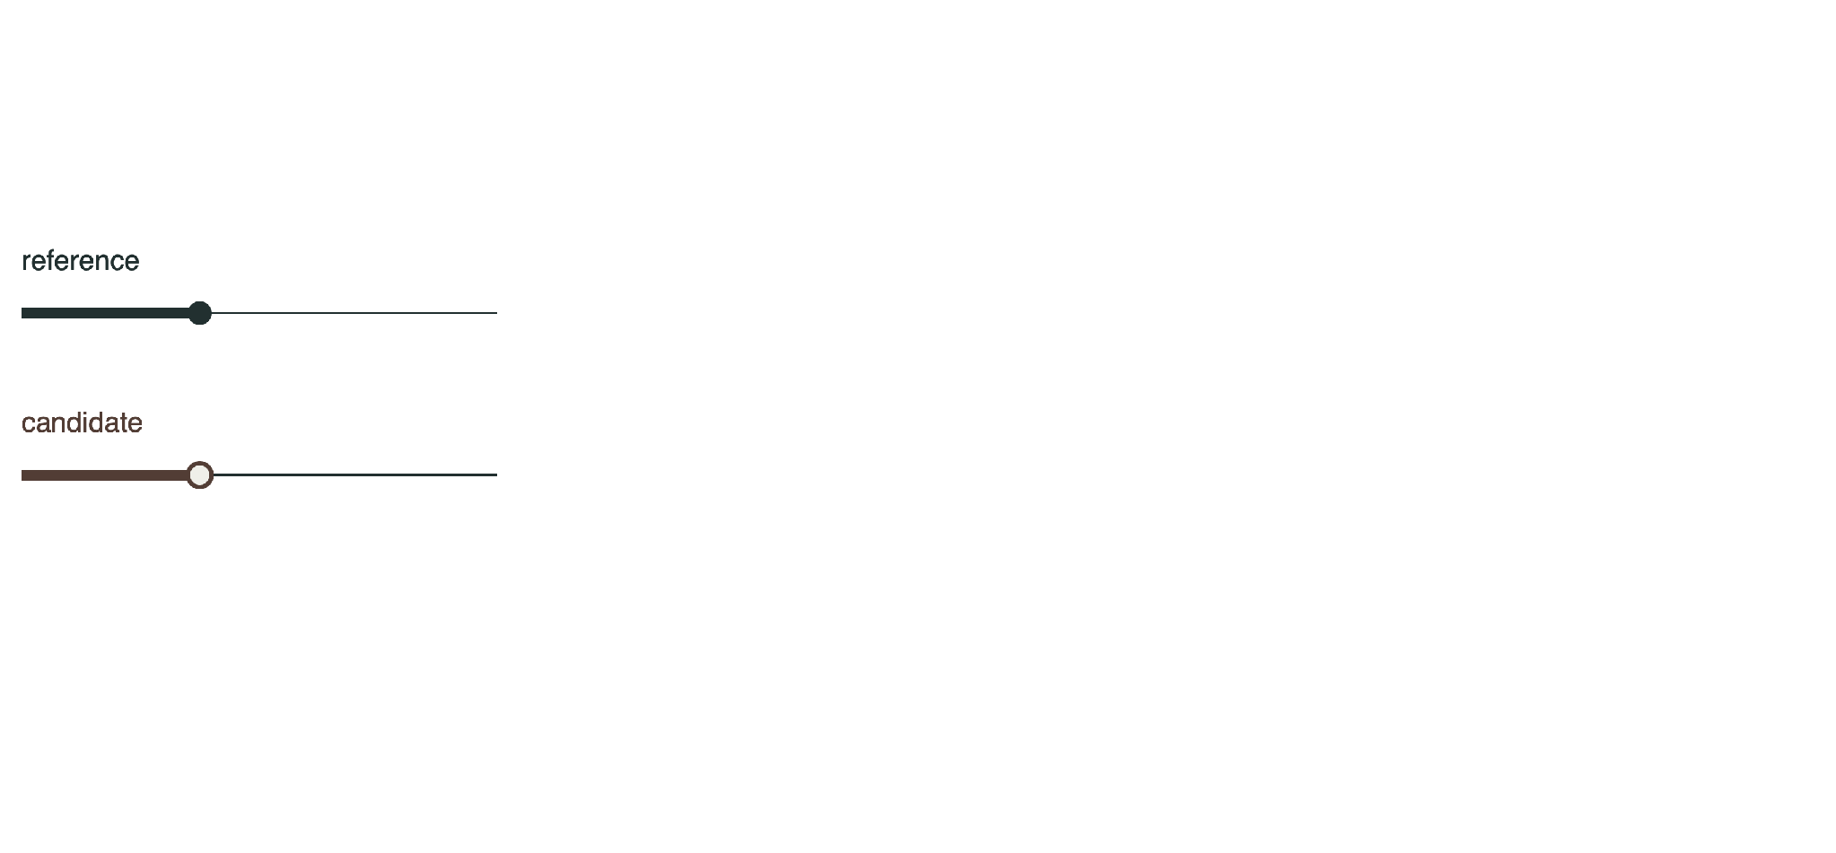
Q3
Does the formal artifact preserve the source meaning?
Faithfulness
A counterexample to equivalence
Question
SMT-LIB · equivalence probe
Z3 output · expected
Is there a day where
they disagree?
(set-logic QF_LIA)
(declare-const days Int)

Slide 43
Q3
Does the formal artifact preserve the source meaning?
Faithfulness
A counterexample to equivalence
Question
SMT-LIB · equivalence probe
Z3 output · expected
Is there a day where
they disagree?
(set-logic QF_LIA)
(declare-const days Int)
(define-fun reference () Bool
(<= days 30))
(define-fun candidate () Bool
(< days 30))

Slide 44
Q3
Does the formal artifact preserve the source meaning?
Faithfulness
A counterexample to equivalence
Question
SMT-LIB · equivalence probe
Z3 output · expected
Is there a day where
they disagree?
(set-logic QF_LIA)
(declare-const days Int)
(define-fun reference () Bool
(<= days 30))
(define-fun candidate () Bool
(< days 30))
(assert (xor reference candidate))
(check-sat)
(get-value (days))

Slide 45
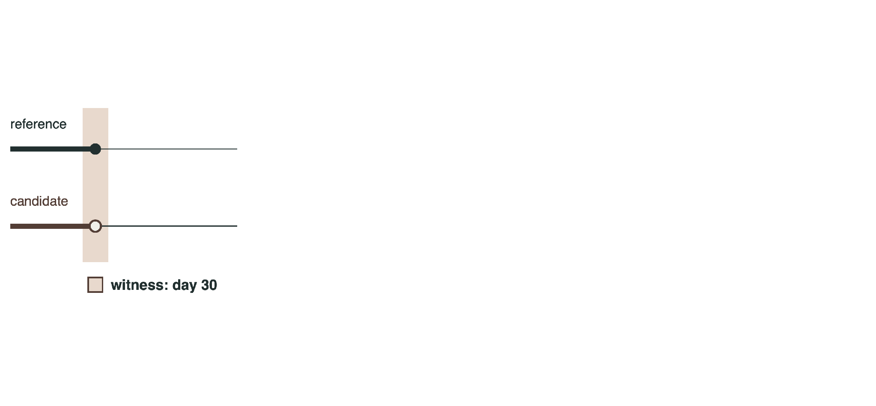
Q3
Does the formal artifact preserve the source meaning?
Faithfulness
A counterexample to equivalence
Question
SMT-LIB · equivalence probe
Z3 output · expected
Is there a day where
they disagree?
(set-logic QF_LIA)
(declare-const days Int)
(define-fun reference () Bool
(<= days 30))
(define-fun candidate () Bool
(< days 30))
(assert (xor reference candidate))
(check-sat)
sat
(get-value (days))
((days 30))
One permits day 30, the other excludes it. The check needs a designated reference and a shared vocabulary.

Slide 46
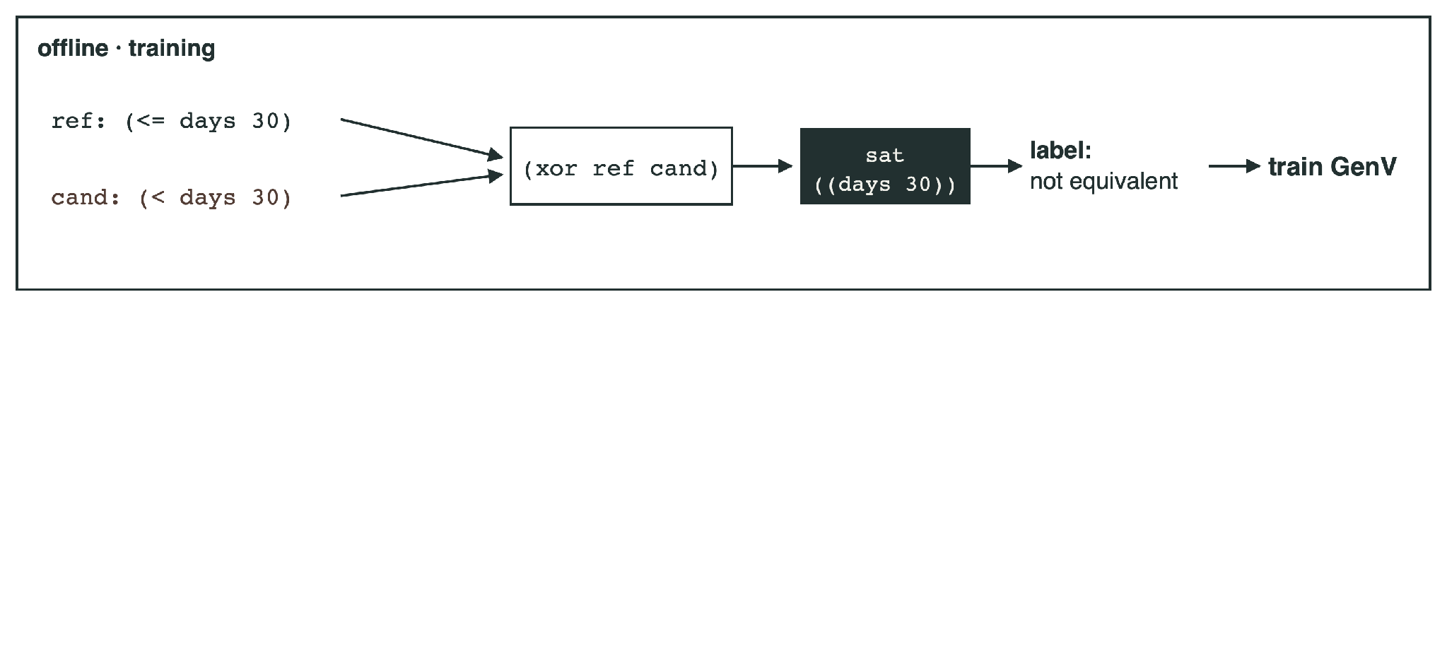
Q3
Does the formal artifact preserve the source meaning?
Faithfulness
Beyond Solver Verdicts
Beyond Solver Verdicts: Generative Reward Models for Autoformalization, Singh et al. , 2026

Slide 47
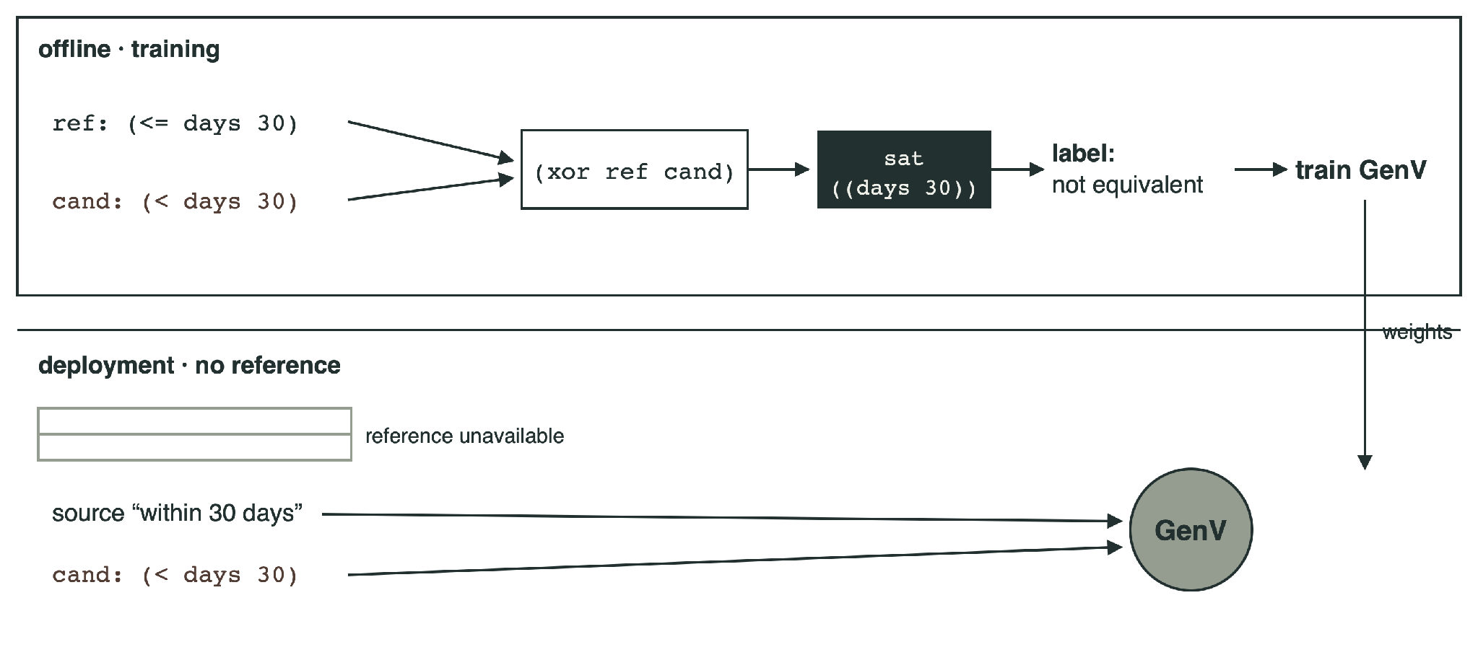
Q3
Does the formal artifact preserve the source meaning?
Faithfulness
Beyond Solver Verdicts
Beyond Solver Verdicts: Generative Reward Models for Autoformalization, Singh et al. , 2026

Slide 48
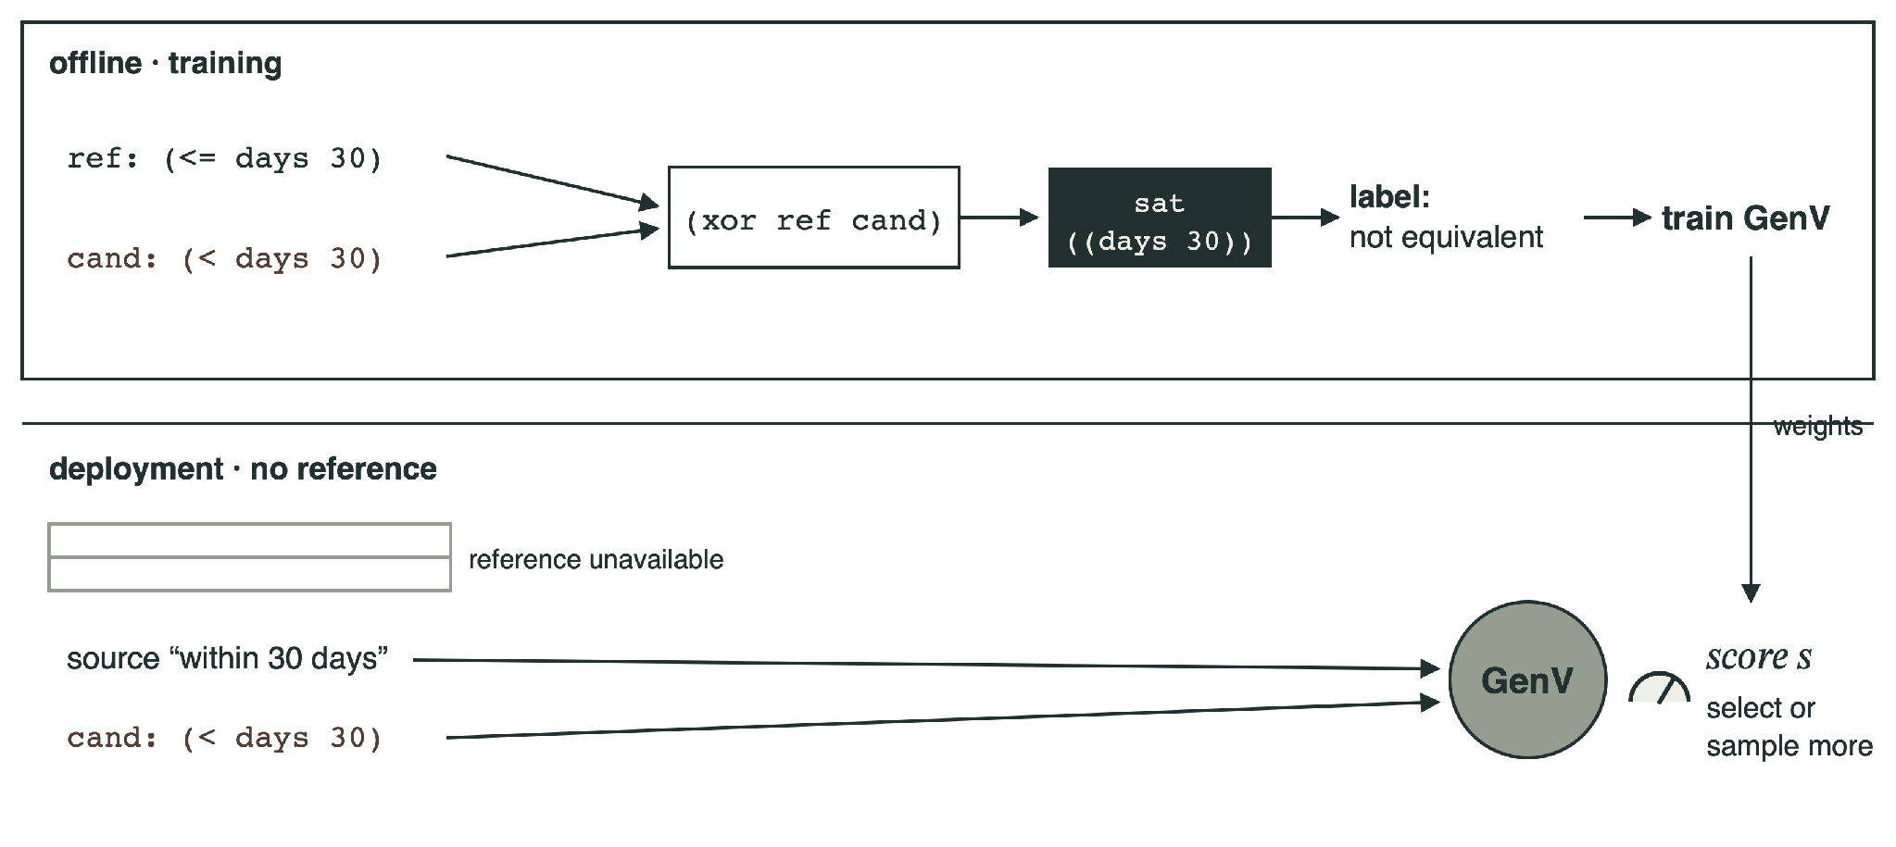
Q3
Does the formal artifact preserve the source meaning?
Faithfulness
Beyond Solver Verdicts
Beyond Solver Verdicts: Generative Reward Models for Autoformalization, Singh et al. , 2026

Slide 49
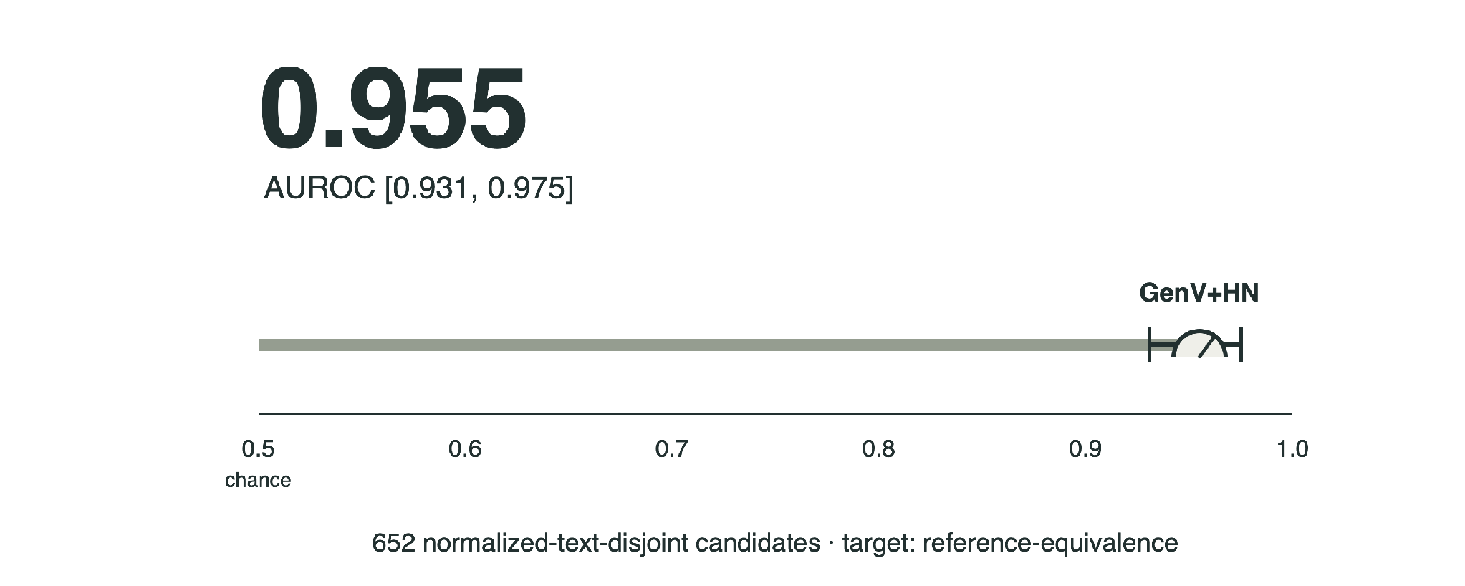
Q3
Does the formal artifact preserve the source meaning?
Faithfulness
Reference-equivalence results
Detecting a suspect artifact is not repairing an answer.
Beyond Solver Verdicts: Generative Reward Models for Autoformalization, Singh et al. , 2026

Slide 50
Q4
Can verification help a model revise its answer?
Revision
VERGE: verification guides inference
Model draft
“Maya’s refund was approved. She returned the item on day 31. She will be happy with the refund.”
Consensus among formalizations is agreement, not proof of source meaning.
VERGE: Formal Refinement and Guidance Engine for Verifiable LLM Reasoning , singh et.al. , 2026

Slide 51
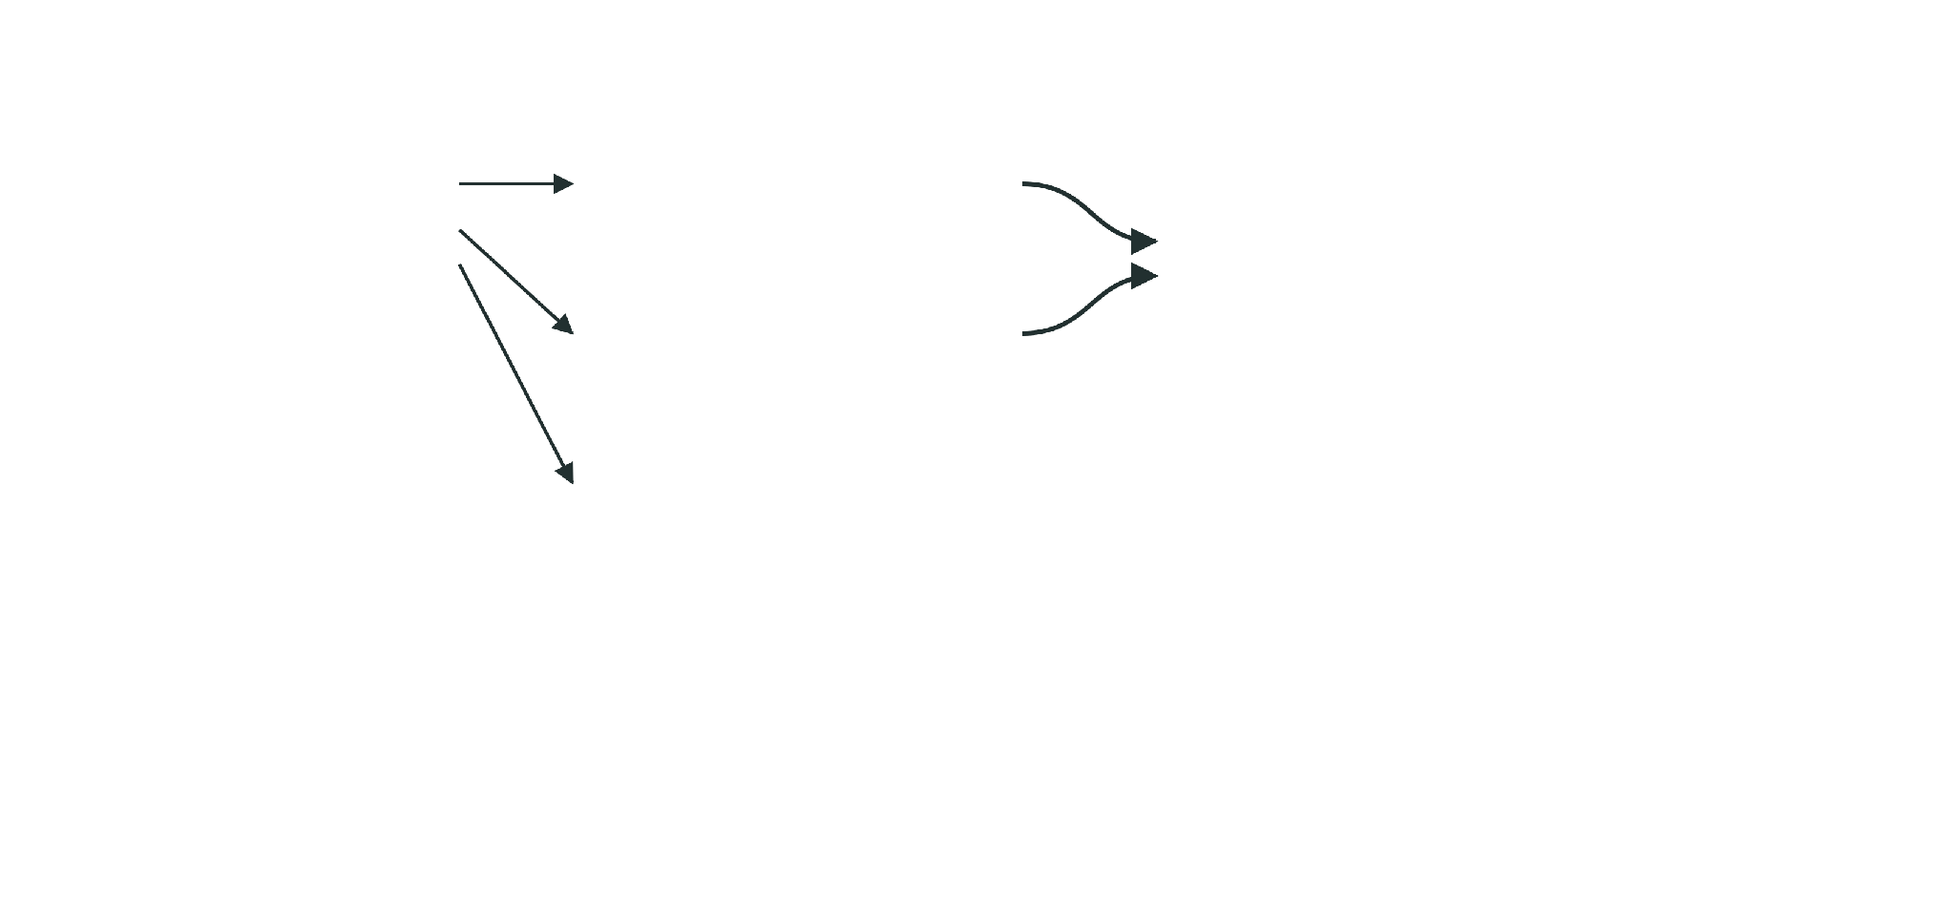
Q4
Can verification help a model revise its answer?
Revision
VERGE: verification guides inference
Model draft
Atomic claims
Routing
“Maya’s refund was approved. She returned the item on day 31. She will be happy with the refund.”
1
approved
formal: SMT check
against the protected context
2
(= days 31)
k formalizations, grouped by equivalence
3
happy with refund
Consensus among formalizations is agreement, not proof of source meaning.
VERGE: Formal Refinement and Guidance Engine for Verifiable LLM Reasoning , singh et.al. , 2026

Slide 52
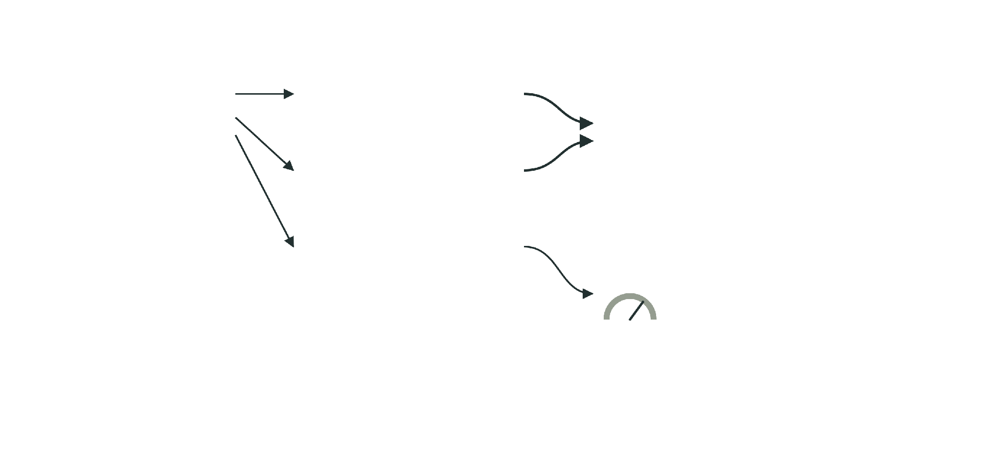
Q4
Can verification help a model revise its answer?
Revision
VERGE: verification guides inference
Model draft
Atomic claims
Routing
“Maya’s refund was approved. She returned the item on day 31. She will be happy with the refund.”
1
approved
formal: SMT check
against the protected context
2
(= days 31)
k formalizations, grouped by equivalence
3
happy with refund
soft: LLM ensemble
judgement, not entailment
Consensus among formalizations is agreement, not proof of source meaning.
VERGE: Formal Refinement and Guidance Engine for Verifiable LLM Reasoning , singh et.al. , 2026

Slide 53
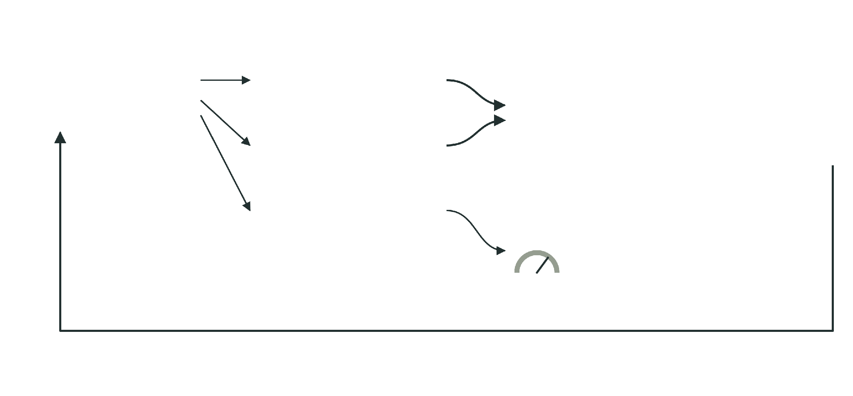
Q4
Can verification help a model revise its answer?
Revision
VERGE: verification guides inference
Model draft
Atomic claims
Routing
“Maya’s refund was approved. She returned the item on day 31. She will be happy with the refund.”
1
approved
formal: SMT check
against the protected context
2
(= days 31)
k formalizations, grouped by equivalence
3
happy with refund
soft: LLM ensemble
judgement, not entailment
feedback to generation
Consensus among formalizations is agreement, not proof of source meaning.
VERGE: Formal Refinement and Guidance Engine for Verifiable LLM Reasoning , singh et.al. , 2026

Slide 54

Q4
Can verification help a model revise its answer?
Revision
Localizing the conflicting claim
Claims
SMT-LIB
Z3 output · expected
(set-option :produce-unsat-cores true)
approved ⇒ days ≤ 30
(set-logic QF_LIA)
approved
(declare-const approved Bool)
(declare-const days Int)
protected source premises
(assert (=> approved (<= days 30)))
(assert approved)
VERGE: Formal Refinement and Guidance Engine for Verifiable LLM Reasoning , singh et.al. , 2026

Slide 55

Q4
Can verification help a model revise its answer?
Revision
Localizing the conflicting claim
Claims
SMT-LIB
Z3 output · expected
(set-option :produce-unsat-cores true)
approved ⇒ days ≤ 30
(set-logic QF_LIA)
approved
(declare-const approved Bool)
(declare-const days Int)
protected source premises
(assert (=> approved (<= days 30)))
(assert approved)
(push 1)
claim31
days = 31
(assert (! (= days 31) :named claim31))
editable generated claim
VERGE: Formal Refinement and Guidance Engine for Verifiable LLM Reasoning , singh et.al. , 2026

Slide 56
Q4
Can verification help a model revise its answer?
Revision
Localizing the conflicting claim
Claims
SMT-LIB
Z3 output · expected
(set-option :produce-unsat-cores true)
approved ⇒ days ≤ 30
(set-logic QF_LIA)
approved
(declare-const approved Bool)
(declare-const days Int)
protected source premises
(assert (=> approved (<= days 30)))
(assert approved)
(push 1)
claim31
days = 31
(assert (! (= days 31) :named claim31))
editable generated claim
(check-sat)
unsat
conflict
(get-unsat-core)
(claim31)
VERGE: Formal Refinement and Guidance Engine for Verifiable LLM Reasoning , singh et.al. , 2026

Slide 57
Q4
Can verification help a model revise its answer?
Revision
Localizing the conflicting claim
Claims
SMT-LIB
Z3 output · expected
(set-option :produce-unsat-cores true)
approved ⇒ days ≤ 30
(set-logic QF_LIA)
approved
(declare-const approved Bool)
(declare-const days Int)
protected source premises
(assert (=> approved (<= days 30)))
(assert approved)
(push 1)
claim31
days = 31
(assert (! (= days 31) :named claim31))
editable generated claim
(check-sat)
unsat
conflict
(get-unsat-core)
(claim31)
(pop 1)
(check-sat)
sat
restored
The core names claim31. Removing only that editable claim restores consistency.
VERGE: Formal Refinement and Guidance Engine for Verifiable LLM Reasoning , singh et.al. , 2026

Slide 58

Q4
Can verification help a model revise its answer?
Revision
Repair, then verify again
Claims
SMT-LIB
Z3 output · expected
; protected context from last slide
approved ⇒ days ≤ 30
approved
days = 31
rev
days ≤ 30
VERGE: Formal Refinement and Guidance Engine for Verifiable LLM Reasoning , singh et.al. , 2026

Slide 59
Q4
Can verification help a model revise its answer?
Revision
Repair, then verify again
Claims
SMT-LIB
Z3 output · expected
; protected context from last slide
approved ⇒ days ≤ 30
(push 1)
approved
(assert (! (<= days 30) :named rev))
(check-sat)
sat
consistent
days = 31
(pop 1)
rev
days ≤ 30
VERGE: Formal Refinement and Guidance Engine for Verifiable LLM Reasoning , singh et.al. , 2026

Slide 60
Q4
Can verification help a model revise its answer?
Revision
Repair, then verify again
Claims
SMT-LIB
Z3 output · expected
; protected context from last slide
approved ⇒ days ≤ 30
(push 1)
approved
(assert (! (<= days 30) :named rev))
(check-sat)
sat
consistent
days = 31
(pop 1)
(push 1)
(assert (not (<= days 30)))
rev
days ≤ 30
(check-sat)
unsat
entailed ✓
(pop 1)
VERGE: Formal Refinement and Guidance Engine for Verifiable LLM Reasoning , singh et.al. , 2026

Slide 61
Q4
Can verification help a model revise its answer?
Revision
Repair, then verify again
Claims
SMT-LIB
Z3 output · expected
; protected context from last slide
approved ⇒ days ≤ 30
(push 1)
approved
(assert (! (<= days 30) :named rev))
(check-sat)
sat
consistent
days = 31
(pop 1)
(push 1)
(assert (not (<= days 30)))
rev
days ≤ 30
(check-sat)
unsat
entailed ✓
(pop 1)
draft
→
diagnose
→
repair
→
The revised claim is consistent with the context and entailed by it.
recheck
VERGE: Formal Refinement and Guidance Engine for Verifiable LLM Reasoning , singh et.al. , 2026

Slide 62
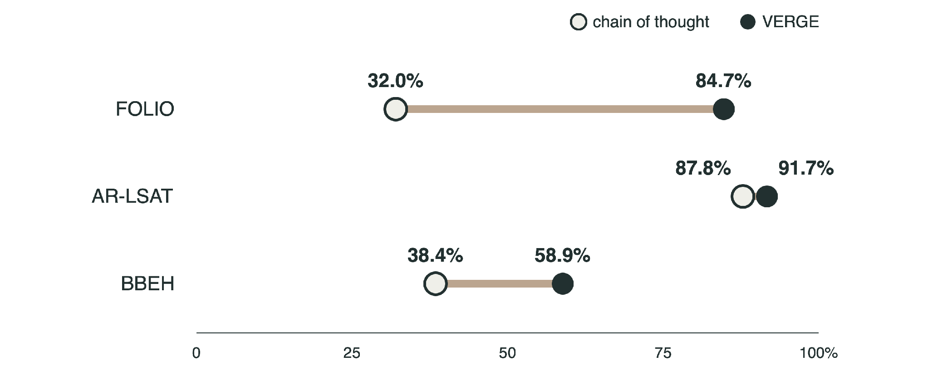
Q4
Can verification help a model revise its answer?
Revision
VERGE results (GPT - OSS - 120B)
VERGE: Formal Refinement and Guidance Engine for Verifiable LLM Reasoning , singh et.al. , 2026

Slide 63
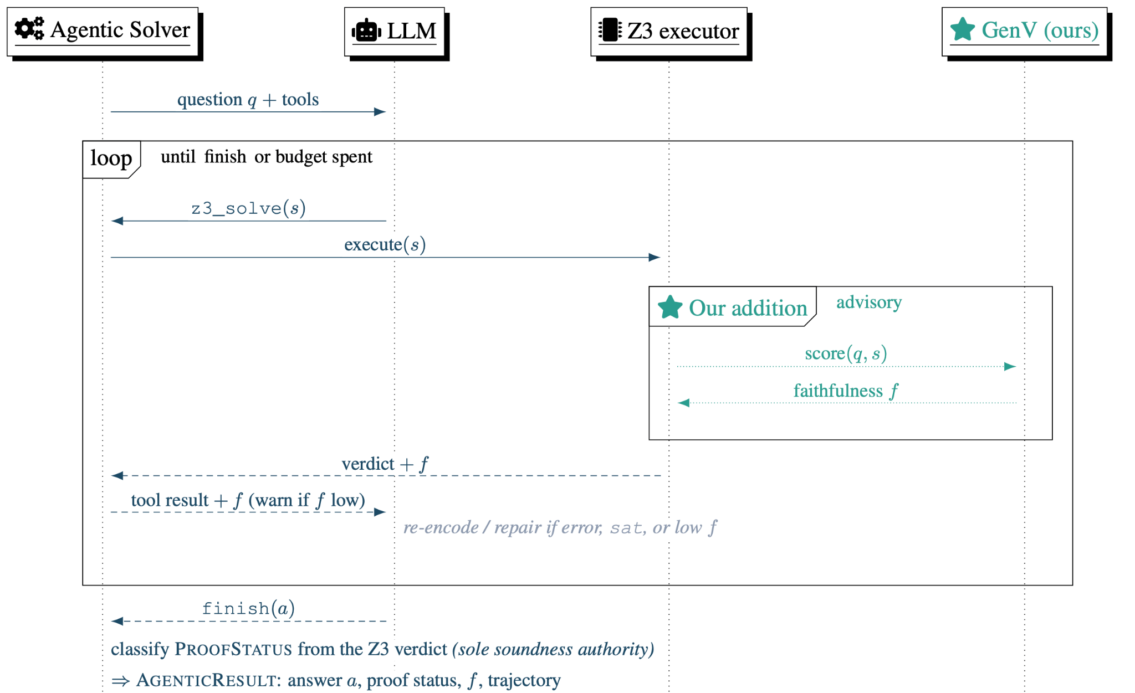
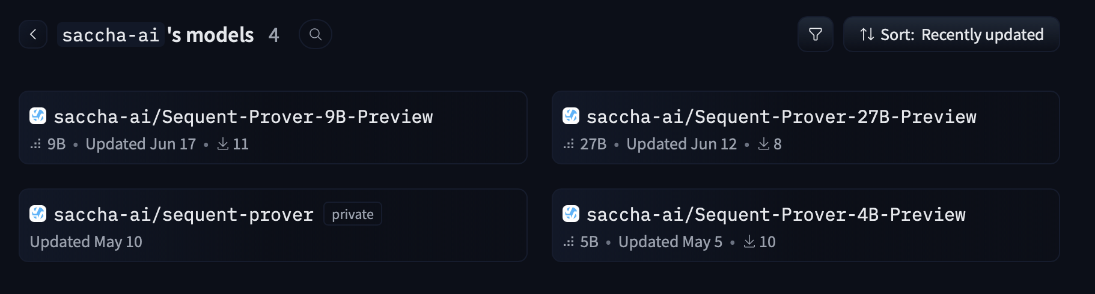
Q5
Can we use formal verification in training?
Revision
Sequent Prover model series
Sequent prover: Training Agents for Formal, checkable SMT-based reasoning. Ganguly et. al. , 2026

Slide 64
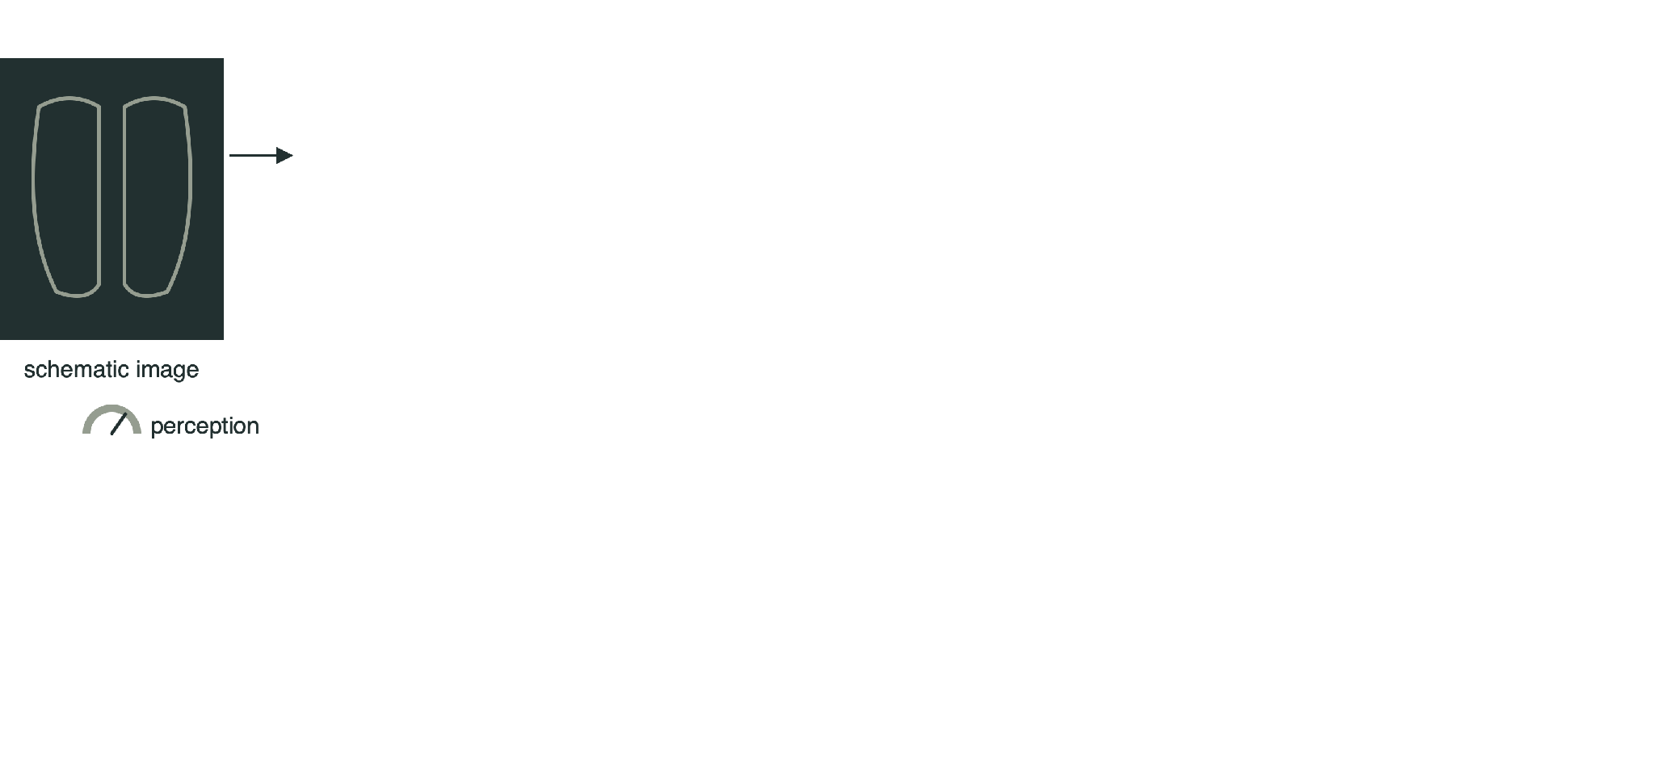
Bridge
Where else does the same check apply?
A clinical reasoning application
FINDINGS
Right lower lobe opacity with air bronchograms .
IMPRESSION
Pneumonia.
Illustrative case modeled on the paper’s motivating example.
Toward Guarantees for Clinical Reasoning in Vision Language Models via Formal Verification, Singh et al., 2026

Slide 65
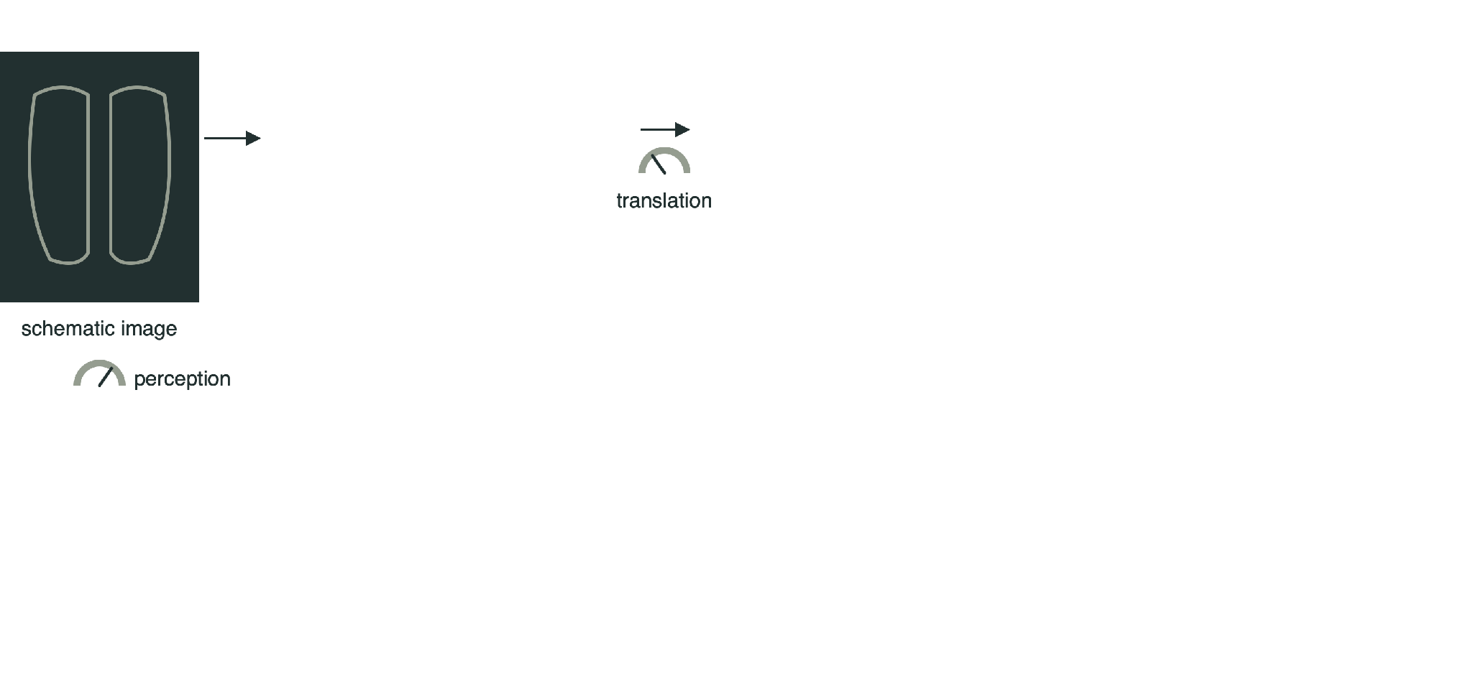
Bridge
Where else does the same check apply?
A clinical reasoning application
SMT-LIB · rules abbreviated as R
Result
FINDINGS
Right lower lobe opacity with air bronchograms .
; E: stated findings
(assert rll_opacity)
(assert air_bronchogram)
IMPRESSION
; R: knowledge-base rules
Pneumonia.
(check-sat)
sat
Illustrative case modeled on the paper’s motivating example.
Toward Guarantees for Clinical Reasoning in Vision Language Models via Formal Verification, Singh et al., 2026

Slide 66
Bridge
Where else does the same check apply?
A clinical reasoning application
SMT-LIB · rules abbreviated as R
Result
FINDINGS
Right lower lobe opacity with air bronchograms .
; E: stated findings
(assert rll_opacity)
(assert air_bronchogram)
IMPRESSION
; R: knowledge-base rules
Pneumonia.
(check-sat)
sat
(check-sat-assuming
((not pneumonia)))
unsat
pneumonia follows ✓
Illustrative case modeled on the paper’s motivating example.
The check concerns findings to impression. It does not inspect the image.
Toward Guarantees for Clinical Reasoning in Vision Language Models via Formal Verification, Singh et al., 2026

Slide 67

Bridge
Where else does the same check apply?
Lean and domain-specific proof
Informal source
Lean 4 · schematic
theorem target
a stochastic-process statement in a textbook
(h₁ : hypothesis₁)
(h₂ : hypothesis₂) :
statement := by
generated proof
hypotheses
generated
StochBench
450 stochastic-process targets, each paired with its informal source
A kernel-checked proof establishes the statement under its hypotheses.
StochBench: A Domain-Specific Benchmark for Stochastic Processes in Lean, Davidovich et. al. , 2026

Slide 68
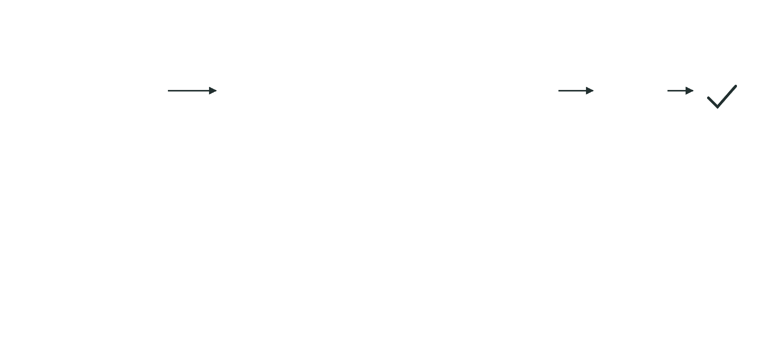
Bridge
Where else does the same check apply?
Lean and domain-specific proof
Informal source
Lean 4 · schematic
theorem target
(h₁ : hypothesis₁)
accepted, no sorry
a stochastic-process statement in a textbook
kernel
(h₂ : hypothesis₂) :
statement := by
generated proof
hypotheses
generated
StochBench
450 stochastic-process targets, each paired with its informal source
A kernel-checked proof establishes the statement under its hypotheses.
StochBench: A Domain-Specific Benchmark for Stochastic Processes in Lean, Singh et al. · results in backup B7

Slide 69
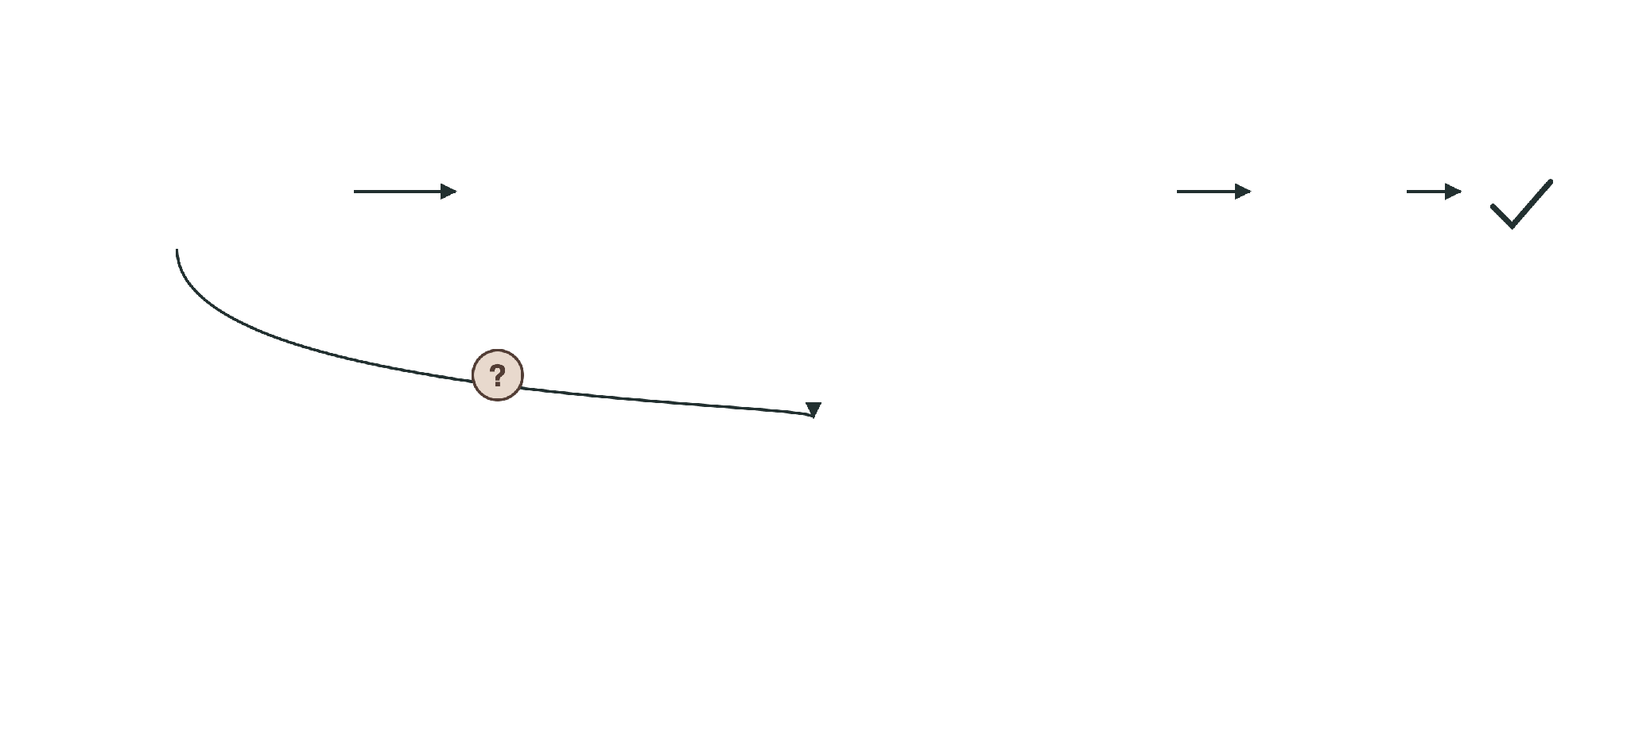
Bridge
Where else does the same check apply?
Lean and domain-specific proof
Informal source
Lean 4 · schematic
theorem target
(h₁ : hypothesis₁)
accepted, no sorry
a stochastic-process statement in a textbook
kernel
(h₂ : hypothesis₂) :
statement := by
generated proof
hypotheses
generated
Does the theorem state the intended mathematics? A separate review.
StochBench
450 stochastic-process targets, each paired with its informal source
A kernel-checked proof establishes the statement under its hypotheses.
StochBench: A Domain-Specific Benchmark for Stochastic Processes in Lean, Davidovich et. al. , 2026

Slide 70

Q5
Can formal checks control which actions execute?
Agent actions
Ongoing work: checking agent actions
ongoing work
Task
Read the report summary and send the attachment to the partner.
agent
proposes calls

Slide 71

Q5
Can formal checks control which actions execute?
Agent actions
Ongoing work: checking agent actions
ongoing work
Task
Read the report summary and send the attachment to the partner.
read_summary(
doc: S-12)
agent
proposes calls
send_attachment(
file: A-7, to: R-3)

Slide 72
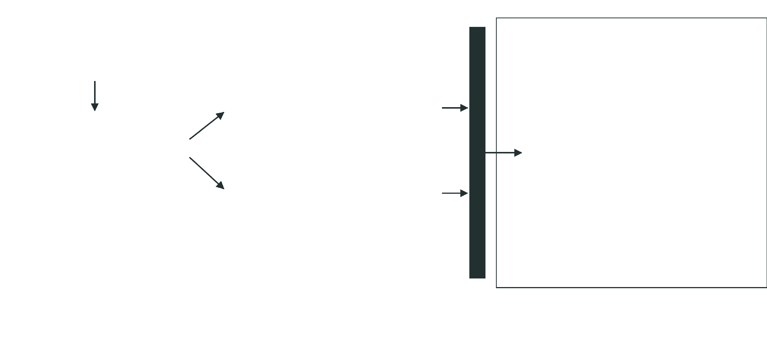
Q5
Can formal checks control which actions execute?
Agent actions
Ongoing work: checking agent actions
ongoing work
Task
Read the report summary and send the attachment to the partner.
side effects happen only here
read_summary(
doc: S-12)
agent
executor
proposes calls
documents · email
send_attachment(
file: A-7, to: R-3)
policy gate
The agent proposes a call. The executor controls its side effects.

Slide 73
Q5
Can formal checks control which actions execute?
Agent actions
Permissions, denials, and trusted facts
ongoing work
Policy
grant
Read public summaries.
grant
Send attachments to project collaborators.
deny
Never send a restricted attachment outside our organization.
order
Denials override permissions.
default
Otherwise deny.
The collaborator grant applies, and the external-restricted denial overrides it.

Slide 74
Q5
Can formal checks control which actions execute?
Agent actions
Permissions, denials, and trusted facts
ongoing work
Policy
Trusted resolver, not the model
grant
Read public summaries.
summary_public = true
grant
Send attachments to project collaborators.
recipient_collaborator = true
recipient_external = true
deny
Never send a restricted attachment outside our organization.
attachment_restricted = true
order
Denials override permissions.
Document text cannot change these facts or the policy.
default
Otherwise deny.
The collaborator grant applies, and the external-restricted denial overrides it.

Slide 75
Q5
Can formal checks control which actions execute?
Agent actions
Permissions, denials, and trusted facts
ongoing work
Policy
Trusted resolver, not the model
Decision
grant
Read public summaries.
permit = allow ∧ ¬deny
summary_public = true
grant
Send attachments to project collaborators.
recipient_collaborator = true
allow
deny
recipient_external = true
read
true
false
permitted ✓
deny
Never send a restricted attachment outside our organization.
attachment_restricted = true
send
true
true
denied ✗
order
Denials override permissions.
Document text cannot change these facts or the policy.
default
Otherwise deny.
The collaborator grant applies, and the external-restricted denial overrides it.

Slide 76
Q5
Can formal checks control which actions execute?
Agent actions
Permissions, denials, and trusted facts
ongoing work
Policy
Trusted resolver, not the model
Decision
grant
Read public summaries.
permit = allow ∧ ¬deny
summary_public = true
grant
Send attachments to project collaborators.
recipient_collaborator = true
allow
deny
recipient_external = true
read
true
false
permitted ✓
deny
Never send a restricted attachment outside our organization.
attachment_restricted = true
send
true
true
denied ✗
order
Denials override permissions.
Document text cannot change these facts or the policy.
default
Otherwise deny.
?
unresolved
a needed fact is missing: withhold and report, not a denial
The collaborator grant applies, and the external-restricted denial overrides it.

Slide 77
Q5
Can formal checks control which actions execute?
Agent actions
The SMT gate before a tool call
ongoing work
Meaning of each query
SMT-LIB · excerpt
Z3 output · captured
(define-fun permit () Bool
(and allow (not deny)))
; allow, deny, 4 facts: see B8
Same verdict, opposite meanings. Read every result with its query.

Slide 78
Q5
Can formal checks control which actions execute?
Agent actions
The SMT gate before a tool call
ongoing work
Meaning of each query
SMT-LIB · excerpt
Z3 output · captured
(define-fun permit () Bool
(and allow (not deny)))
; allow, deny, 4 facts: see B8
(check-sat)
sat
consistent
Same verdict, opposite meanings. Read every result with its query.

Slide 79
Q5
Can formal checks control which actions execute?
Agent actions
The SMT gate before a tool call
ongoing work
Meaning of each query
SMT-LIB · excerpt
Z3 output · captured
(define-fun permit () Bool
(and allow (not deny)))
; allow, deny, 4 facts: see B8
read · assume ¬permit
(check-sat)
sat
consistent
unsat: permission established
(push 1)
(assert (= action ReadSummary))
(assert (not permit))
(check-sat)
unsat
read ✓
(pop 1)
Same verdict, opposite meanings. Read every result with its query.

Slide 80
Q5
Can formal checks control which actions execute?
Agent actions
The SMT gate before a tool call
ongoing work
Meaning of each query
SMT-LIB · excerpt
Z3 output · captured
(define-fun permit () Bool
(and allow (not deny)))
; allow, deny, 4 facts: see B8
read · assume ¬permit
(check-sat)
sat
consistent
unsat: permission established
(push 1)
(assert (= action ReadSummary))
(assert (not permit))
send · assume permit
(check-sat)
unsat
read ✓
unsat: denial established
(pop 1)
(push 1)
(assert (= action SendAttachment))
Execute only when permission is established for the exact resolved call.
(assert permit)
(check-sat)
unsat
send ✗
(pop 1)
Withhold on timeout · unknown · inconsistent context · insufficient evidence
Same verdict, opposite meanings. Read every result with its query.

Slide 81
Q5
Can formal checks control which actions execute?
Agent actions
A checked dispatch model in Lean
ongoing work
Lean 4 · excerpt
structure Authorized where
request : Request
permitted : permit request = true

Slide 82
Q5
Can formal checks control which actions execute?
Agent actions
A checked dispatch model in Lean
ongoing work
Lean 4 · excerpt
structure Authorized where
request : Request
permitted : permit request = true
def dispatch (r : Request) (s : State) : State :=
if hp : permit r = true then
applyAuthorized ⟨r, hp⟩ s
else s

Slide 83
Q5
Can formal checks control which actions execute?
Agent actions
A checked dispatch model in Lean
ongoing work
Lean 4 · excerpt
Command trace
structure Authorized where
before
request : Request
readSummary 12
permitted : permit request = true
dispatch send A-7 → R-3 · denied
def dispatch (r : Request) (s : State) : State :=
after
if hp : permit r = true then
nothing added
applyAuthorized ⟨r, hp⟩ s
readSummary 12
else s
theorem denied_no_transition
(r : Request) (s : State)
network and tools: outside the pure model
(hd : deny r = true) :
dispatch r s = s

Slide 84
Q5
Can formal checks control which actions execute?
Agent actions
A checked dispatch model in Lean
ongoing work
Lean 4 · excerpt
Command trace
structure Authorized where
before
request : Request
readSummary 12
permitted : permit request = true
dispatch send A-7 → R-3 · denied
def dispatch (r : Request) (s : State) : State :=
after
if hp : permit r = true then
nothing added
applyAuthorized ⟨r, hp⟩ s
readSummary 12
else s
theorem denied_no_transition
(r : Request) (s : State)
network and tools: outside the pure model
(hd : deny r = true) :
dispatch r s = s
The theorem covers the modeled trace only.
Not the truth of resolved facts, not the policy translation. A Z3 result string is not a Lean proof.

Slide 85
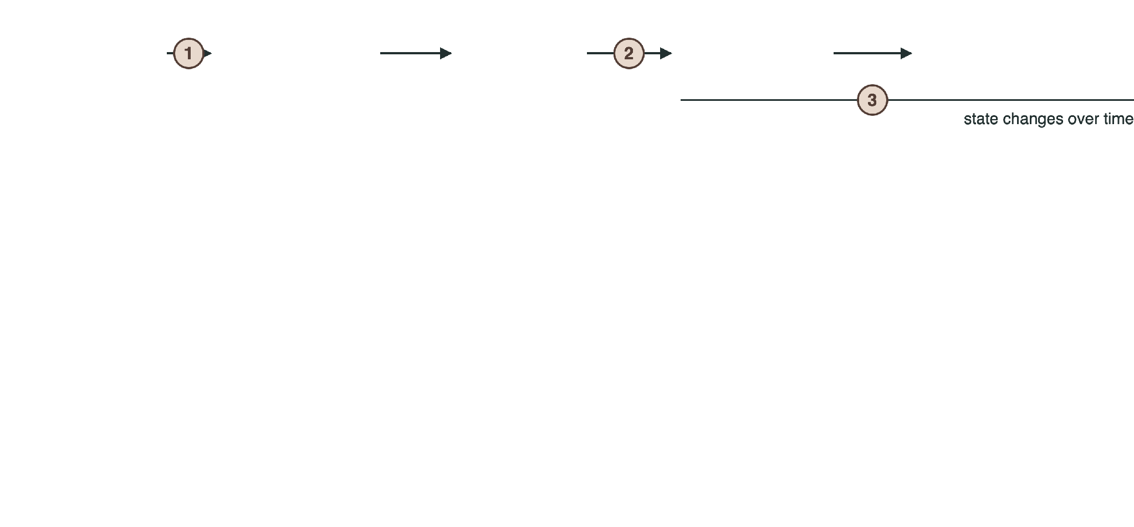
Q5
Can formal checks control which actions execute?
Agent actions
The open research problems
ongoing work
policy text
formal policy
check
checked call
execution

Slide 86
Q5
Can formal checks control which actions execute?
Agent actions
The open research problems
ongoing work
policy text
formal policy
check
checked call
execution
1 · Policy meaning
2 · Checked-call binding
3 · Changing state
drop “outside” from the restricted rule
swap the attachment after checking
revoke membership before commit
instructions inside an untrusted document
change the recipient after checking
a stale classification
a misleading classification from a document
replay a retry
continue the permitted read after a denial

Slide 87
Q5
Can formal checks control which actions execute?
Agent actions
The open research problems
ongoing work
policy text
formal policy
check
checked call
execution
1 · Policy meaning
2 · Checked-call binding
3 · Changing state
drop “outside” from the restricted rule
swap the attachment after checking
revoke membership before commit
instructions inside an untrusted document
change the recipient after checking
a stale classification
a misleading classification from a document
replay a retry
continue the permitted read after a denial
Planned measurements · no results yet
denied actions executed
safe task completion
unnecessary blocking
unresolved decisions
checking cost

Slide 88
The complete story
Structured representation
Standard language
Translation reliability
Guided revision
Guarded execution
(<= days 30)
((days 30))
claim31 → rev
send: denied
knowledge_base
Grammars
VeriCoT · GenV
VERGE
ongoing work
Proof of Thought
How can we preserve the intended policy all the way to the action that actually executes?
vikash-singh.me

Slide 89
Questions?
vikash-singh.me

Slide 90
Full JSON adaptation
Backup B1
{
"sorts": [{"name": "Refund",
"type": "DeclareSort"}],
"functions": [
{"name": "approved",
"domain": ["Refund"],
"range": "BoolSort"},
{"name": "days",
"domain": ["Refund"],
"range": "IntSort"}],
"constants": {
"refunds": {"sort": "Refund",
"members": ["maya"]}},
"knowledge_base": ["approved(maya)"],
"rules": [{
"name": "Refund window",
"forall": [{"name": "r",
"sort": "Refund"}],
"implies": {
"antecedent": "approved(r)",
"consequent": "days(r) <= 30"}}],
"verifications": [{
"name": "Maya's return window",
"constraint": "days(maya) <= 30"}],
"actions": ["verify_conditions"]
}
Quantified versus grounded
JSON rule
∀r. approved(r) ⇒ days(r) ≤ 30
SMT-LIB tutorial
approved ⇒ days ≤ 30
instantiated for Maya’s refund
Same conclusion for Maya. The quantified rule covers every refund.
Teaching adaptation of the schema in Proof of Thought: Neurosymbolic Program Synthesis Allows Robust and Interpretable Reasoning, Ganguly et al.

Slide 91
Entailed, contradicted, undetermined
Backup B2
claim q
C ∧ q
C ∧ ¬q
verdict
days ≤ 30
sat
unsat
entailed ✓
days = 12
sat
sat
undetermined ?
days = 31
unsat
sat
contradicted ✗
Check C first
Countermodels vary
No verdict
If C is unsat, every claim looks entailed.
For days ≠ 12, Z3 reports some permitted day. Any day ≤ 30 other than 12 works.
unknown, timeout, or parse error is reported separately.

Slide 92
Related mechanisms
Backup B3
LINC
Logic-LM
VeriCoT
Olausson et al.
Pan et al.
Feng et al.
Language model as semantic parser into FOL.
Task-specific symbolic formulation.
Formalizes each reasoning step.
Solvers: logic programming, FOL prover, CSP, SAT.
Solver checks steps against cited premises.
Prover9 performs deduction.
Majority vote over k sampled parses.
Self-refinement from solver error messages.
Grounding of premises evaluated, possibly by an LLM judge.

Slide 93
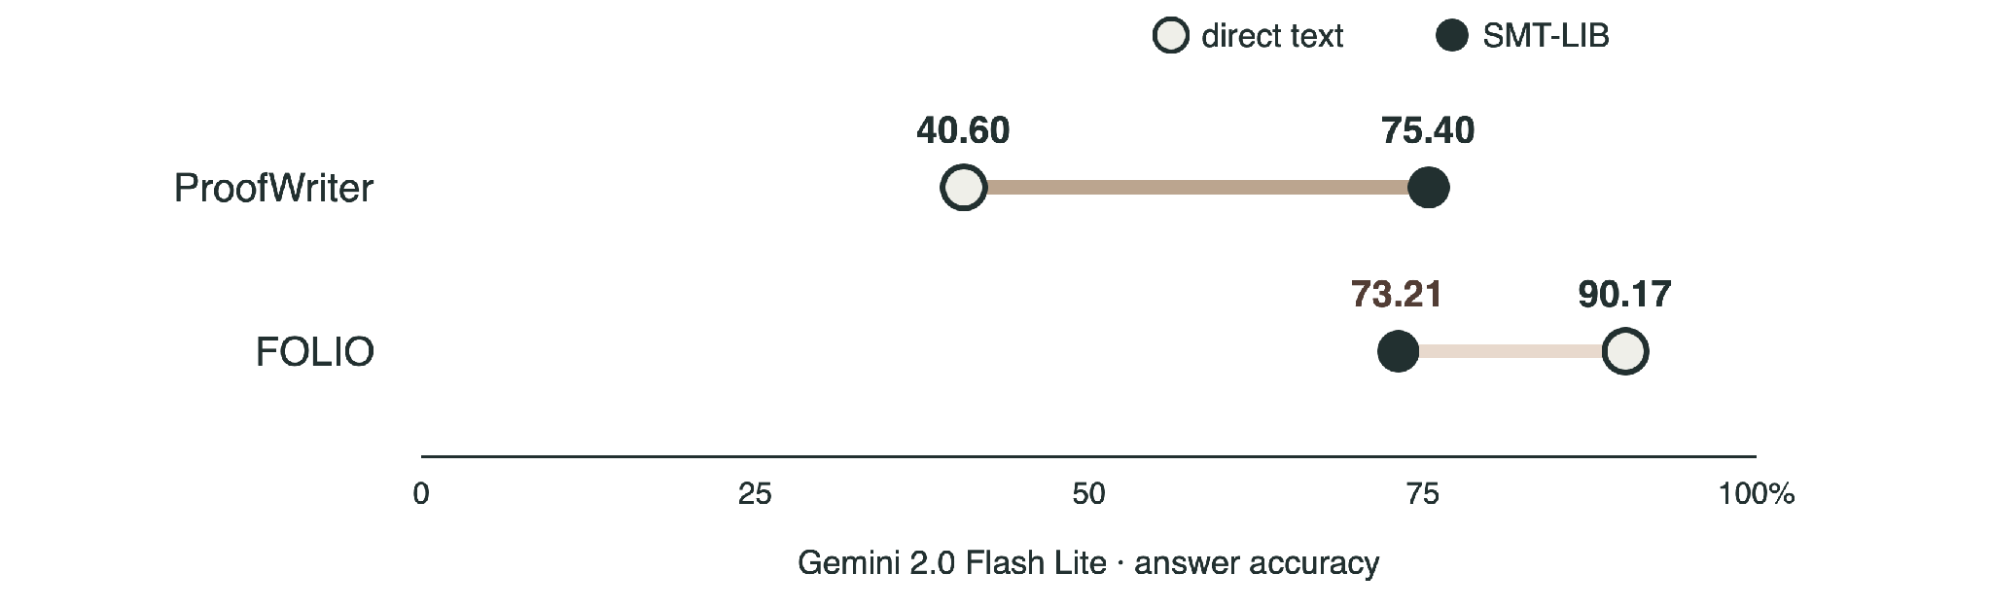
Grammars accuracy and metrics
Backup B4
AUROC
Grammar entropy
chance an incorrect answer gets higher uncertainty than a correct one
entropy of the PCFG fitted to rule counts across samples
Grammars of Formal Uncertainty: When to Trust LLMs in Automated Reasoning Tasks, Singh et al.

Slide 94
GenV scope and evaluation
Backup B5
652 text-disjoint candidates
950 pooled candidates
0.955
0.961
AUROC [0.931, 0.975] · lead result
AUROC · includes text overlap
Oracle
Target
Caveat
Z3 equivalence to a designated reference, shared vocabulary
reference-equivalence, not human intent
the reference is itself a human formalization
Beyond Solver Verdicts: Generative Reward Models for Autoformalization, Singh et al.

Slide 95
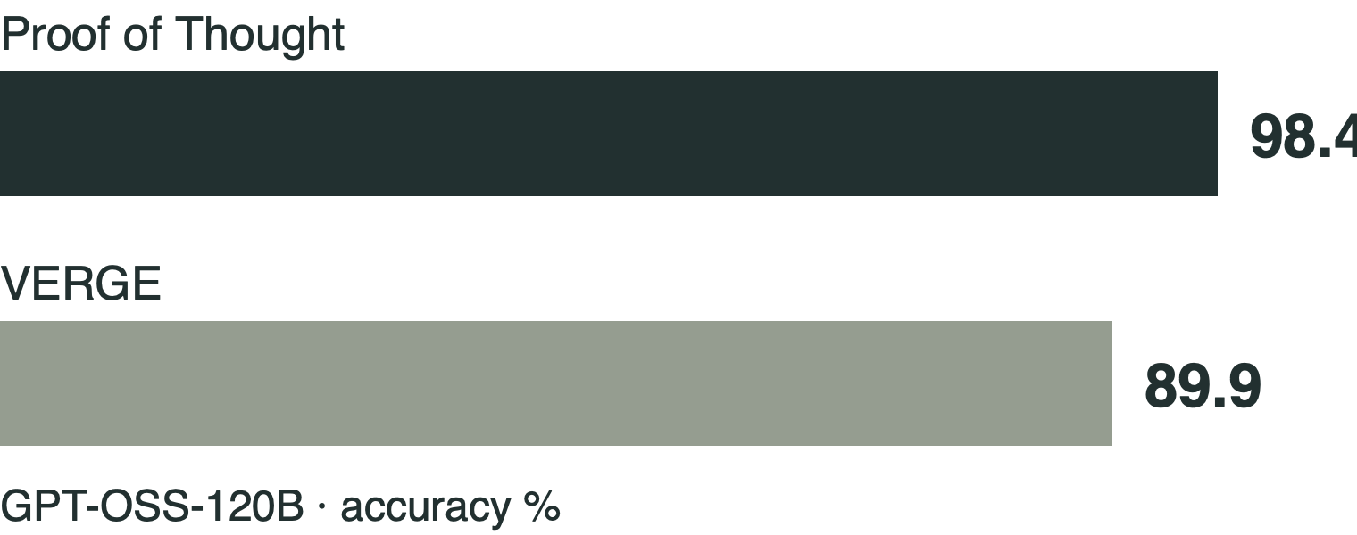
VERGE details
Backup B6
Unsat core
ProofWriter exception
assertions that cannot all hold together
Minimal correction subset
removing it restores consistency; no proper subset does. Computed over editable claims only.
Routing
logical claims to SMT, subjective claims to an LLM ensemble
Budget
up to 3 iterations · 5 runs · baselines: CoT, Proof of Thought
VERGE: Formal Refinement and Guidance Engine for Verifiable LLM Reasoning, Singh et al.

Slide 96

Clinical and StochBench details
Backup B7
Clinical · MedGemma-27B · NIH-CXR14
StochBench
soundness
0.9505
→
0.9780
completeness
0.9488
→
0.9460
precision
+0.1784
157 / 450 clean proofs · 34.9%
recall
−0.0334
114 direct · 336 abstracted · one agent, one run · 15 min per target
Depends on perception, translation, clinician-audited rules, and a closed world: unmentioned findings are false.
Hitting-time illustration
h_{B} = 0, h_{A} = 1 + ½h_{A} + ½h_{B} ⊢ h_{A} = 2
Toward Guarantees for Clinical Reasoning in Vision Language Models via Formal Verification, Singh et al.
by linarith; the recurrence is a hypothesis
StochBench: A Domain-Specific Benchmark for Stochastic Processes in Lean, Singh et al.

Slide 97
Agent policy: full model
Backup B8 · ongoing work
(define-fun allow () Bool
(or (and (= action ReadSummary)
summary_public)
(and (= action SendAttachment)
recipient_collaborator)))
(define-fun deny () Bool
(and (= action SendAttachment)
attachment_restricted
recipient_external))
(define-fun permit () Bool
(and allow (not deny)))
; default deny
(push 1)
(assert (= action Other))
(assert permit)
(check-sat) ; unsat
(pop 1)
; named authorization claim
(push 1)
(assert (= action SendAttachment))
(assert (! permit :named claim_send_allowed))
(check-sat) ; unsat
(get-unsat-core) ; (claim_send_allowed)
(pop 1)
Captured output, in order
sat · unsat · unsat · unsat · unsat · (claim_send_allowed)
Incomplete facts
C ∧ ¬permit unsat: permitted. C ∧ permit unsat: denied. Both sat: unresolved.
Lean, second theorem
theorem restricted_external_send_blocked
... : dispatch r s = s
Related work
AgentSpec · ShieldAgent

